Slide 1
“Light Scattering from Polymer Solutions and Nanoparticle Dispersions”
By: PD Dr. Wolfgang Schaertl
Institut für Physikalische Chemie, Universität Mainz,
Welderweg 11, 55099 Mainz, Germany
schaertl@uni-mainz.de
Parts from the new book of the same title, published by Springer in July 2007
Slides are found at: http://www.uni-mainz.de/FB/Chemie/wschaertl/105.php

Slide 2
1. Light Scattering – Theoretical Background
1.1. Introduction
Light-wave interacts with the charges constituting a given molecule in remodelling
the spatial charge distribution:
Molecule constitutes the emitter of an electromagnetic wave of the same wavelength
as the incident one (“elastic scattering”)
Note: usually vertical polarization of both incident and scattered light (vv-geometry)

Slide 3
Particles larger than 20 nm:
several oscillating dipoles created simultaneously within one given particle
interference leads to a non-isotropic angular dependence of the scattered light intensity
particle form factor, characteristic for size and shape of the scattering particle
scattered intensity I ~ N_{i}M_{i}²P_{i}(q) (scattering vector q, see below!)
Particles smaller than λ/20:
- scattered intensity independent of scattering angle, I ~ N_{i}M_{i}²

Slide 4
Particles in solution show Brownian motion (D = kT/(6πηR), and <Δr(t)²>=6Dt)
=> Interference pattern and resulting scattered intensity fluctuate with time

Slide 5
1.2. Static Light Scattering
Scattered light wave emitted by one oscillating dipole
Detector (photomultiplier, photodiode): scattered intensity only!
I₀
sample
r_{D}
I
detector
Light source I₀ = laser: focussed, monochromatic, coherent
Sample cell: cylindrical quartz cuvette, embedded in toluene bath (T, n_{D})

Slide 6
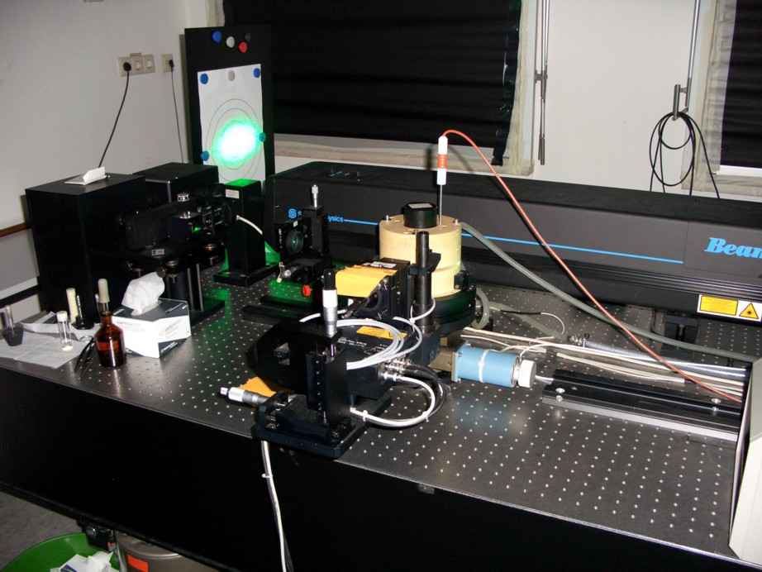
Standard Light Scattering Setup of the Schmidt Group, Phys.Chem., Mainz:
laser
sample,
bath
detector on
goniometer arm

Slide 7
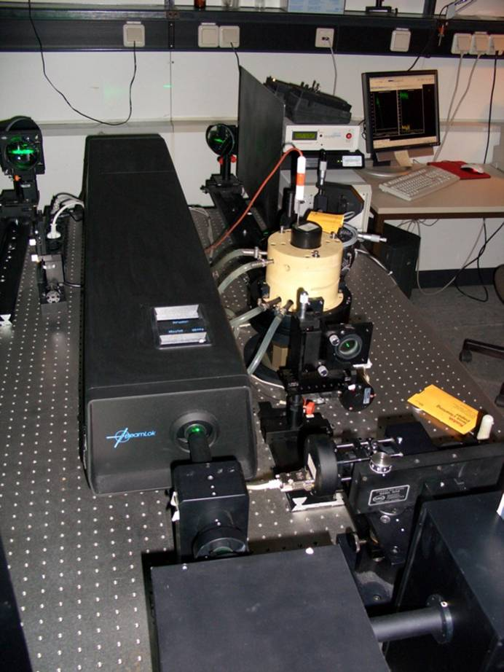
Standard Light Scattering Setup of the Schmidt Group, Phys.Chem., Mainz:

Slide 8
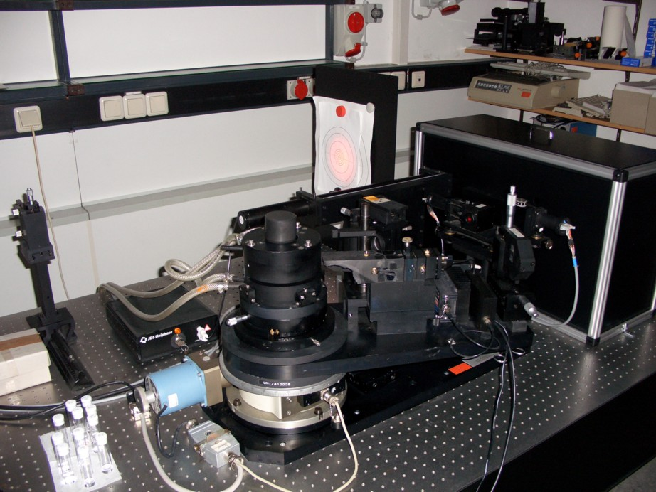
Standard Light Scattering Setup of the Schmidt Group, Phys.Chem., Mainz:

Slide 9
Scattering volume:
defined by intersection of incident beam and optical aperture of the detection optics
.
Important: scattered intensity has to be normalized

Slide 10
Scattering from dilute solutions of very small particles (“point scatterers”)
(e.g. nanoparticles or polymer chains smaller than λ/20)
Fluctuation theory:
contrast factor
in cm²g⁻²Mol
Ideal solutions, van’t Hoff:
Real solutions, enthalpic interactions solvent-solute:
Absolute scattered intensity of ideal solutions, Rayleigh ratio ([cm⁻¹]):
and
Scattering standard I_{std}: Toluene
( I_{abs} = 1.4 e-5 cm⁻¹ )
Reason of “Sky Blue”! (scattering from gas molecules of atmosphere)

Slide 11
Real solutions, enthalpic interactions solvent-solute expressed by 2nd Virial coeff.:
Scattering from dilute solutions of larger particles
- scattered intensity dependent on scattering angle (interference)
The scattering vector q (in [cm⁻¹]) , length scale of the light scattering experiment:

Slide 12
q = inverse observational length scale of the light scattering experiment:
q
q-scale | resolution | information | comment
qR << 1 | whole coil | mass, radius of gyration | e.g. Zimm plot
qR < 1 | topology | cylinder, sphere, …
qR ≈ 1 | topology quantitative | size of cylinder, ...
qR > 1 | chain conformation | helical, stretched, ...
qR >> 1 | chain segments | chain segment density

Slide 13
Scattering from 2 scattering centers – interference of scattered waves
leads to phase difference:
2 interfering waves with phase difference Δ:

Slide 14
Scattered intensity due to Z pair-wise intraparticular interferences, N particles:
orientational average and normalization lead to:
replacing Cartesian coordinates r_{i} by center-of-mass coordinates s_{i} we get:
s², R_{g}² = squared radius of gyration
.
regarding the reciprocal scattered intensity, and including solute-solvent interactions
finally yields the well-known Zimm-Equation (series expansion of P(q), valid for small R):
Zimm equation:

Slide 15
The Zimm-Plot, leading to M, s (= R_{g}) and A₂:
example: 5 c, 25 q
c = 0
q = 0

Slide 16
Zimm analysis of polydisperse samples yields the following averages:
The weight average molar mass
The z-average squared radius of gyration:
Reason: for given species k, I_{k} ~ N_{k}M_{k}²

Slide 17
Fractal Dimensions
if
topology | d_{f}
cylinder, rod | 1
thin disk | 2
homogeneous sphere | 3
ideal Gaussian coil | 2
Gaussian coil with excluded volume | 5/3
branched Gaussian chain | 16/7
:

Slide 18
Particle form factor for “large” particles
for homogeneous spherical particles of radius R:
first minimum at qR = 4.49
Zimm!

Slide 19
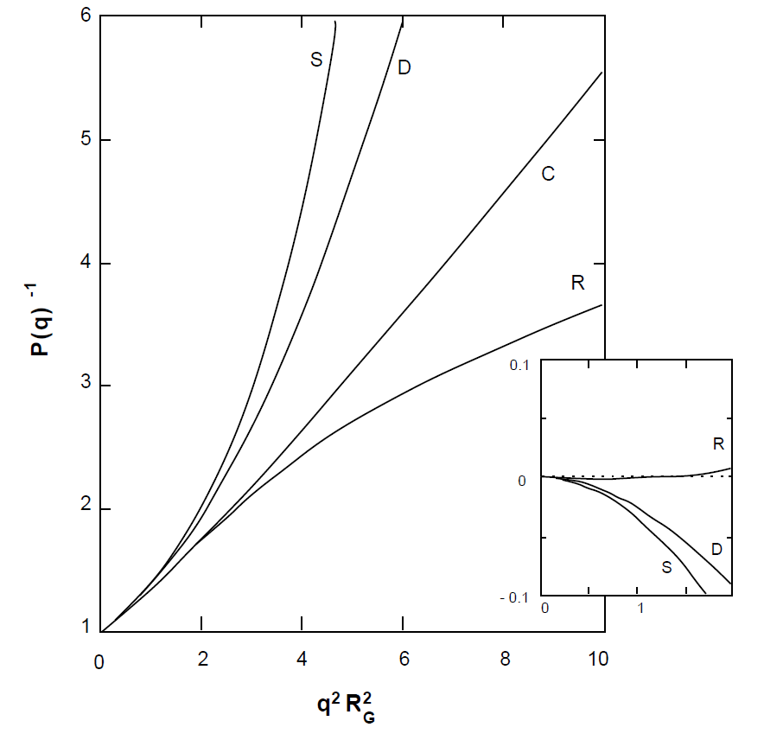
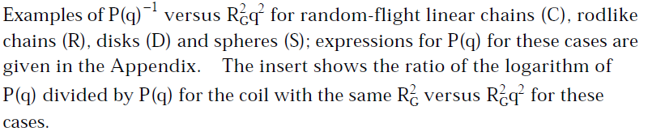

Slide 20
1.3. Dynamic Light Scattering
Brownian motion of the solute particles leads to fluctuations of the scattered intensity
change of particle position with time is expressed by van Hove selfcorrelation function,
DLS-signal is the corresponding Fourier transform (dynamic structure factor)
isotropic diffusive particle motion
mean-squared displacement of the scattering particle:
Stokes-Einstein,
Fluctuation - Dissipation

Slide 21
The Dynamic Light Scattering Experiment - photon correlation spectroscopy
Siegert relation:
note: usually the “coherence factor” f_{c} is smaller than 1, i.e.:
f_{c} increases with decreasing pinhole diameter, but photon count rate decreases!

Slide 22
DLS from polydisperse (bimodal) samples

Slide 23
Data analysis for polydisperse (monomodal) samples
”Cumulant method“, series expansion, only valid for small size polydispersities < 50 %
first Cumulant
yields inverse average hydrodynamic radius
second Cumulant
yields polydispersity
for samples with average particle size larger than 10 nm:
note:

Slide 24
Cumulant analysis – graphic explanation:
monodisperse sample
polydisperse sample
large, slow
particles
small, fast
particles
linear slope yields diffusion coefficient
slope at τ=0 yields apparent diffusion
coefficient, which is an average weighted
with n_{i}M_{i}²P_{i}(q)

Slide 25
D_{app} vs. q²:

Slide 26
Explanation for D_{app}(q):
for larger particle fraction i, P(q) drops first,
leading to an increase of the average D_{app}(q)

Slide 27
ln(g1(τ))=P1+P2*τ+P3/2 *τ^2
PI = SQRT(P3/P2^2)

Slide 31
Combining static and dynamic light scattering, the ρ-ratio:
topology | ρ-ratio
homogeneous sphere | 0.775
hollow sphere | 1
ellipsoid | 0.775 - 4
random polymer coil | 1.505
cylinder of length l, diameter D
for polydisperse samples:

Slide 32
Strategy for particle characterization by light scattering - A
Sample topology (sphere, coil, etc…) is known
yes
no
Dynamic light scattering
sufficient (“particle sizing“)
Static light scattering necessary
Time intensity correlation function decays single-exponentially
yes
no
Only one scattering angle needed, determine particle size (R_{H}) from Stokes-Einstein-Eq.
(in case there are no particle interactions (polyelectrolytes!)
Sample is polydisperse or shows non-diffusive relaxation processes!
to determine “true” average particle size,
extrapolation q -> 0
- to analyze polydispersity, various methods
Applicability of commercial particle sizers!

Slide 33
Strategy for particle characterization by light scattering - B
Sample topology is unknown,
static light scattering necessary
Plot of vs. is linear
yes
no
Particle radius between 10 and 50 nm:
analyze data following Zimm-eq. to get:
Particle radius larger than 50 nm and/or very polydisperse sample:
use more sophisticated methods to evaluate particle form factor
Dynamic light scattering to determine
Estimate (!) particle topology from

Slide 35
2. Static Light Scattering – Selected Examples
1. Galinsky, G.;Burchard, W. Macromolecules 1997, 30, 4445-4453
Samples:
Several starch fractions prepared by controlled acid degradation of potatoe starch
,dissolved in 0.5M NaOH
Sample characteristics obtained for very dilute solutions by Zimm analysis:
sample | 10⁻⁶ M_{w} (g/mol) | R_{g} (nm) | 10⁴ A₂ [(mol cm³)/g²]
LD11 | 0.92 | 36 | 1.00
LD16 | 1.87 | 48 | 0.60
LD12 | 5.20 | 70 | 0.28
LD19 | 14.5 | 113 | 0.13
LD18 | 43 | 180 | 0.082
LD17 | 64 | 190 | 0.060
LD13 | 97 | 233 | 0.025

Slide 36
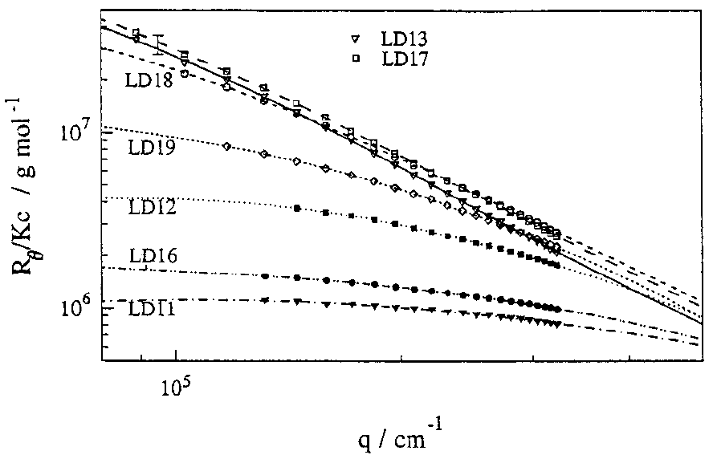
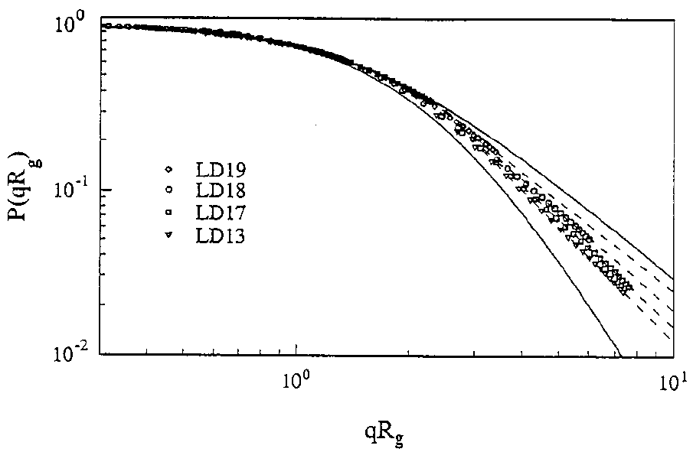
Normalized particle form factors
universal up to values of qR_{g} = 2

Slide 37
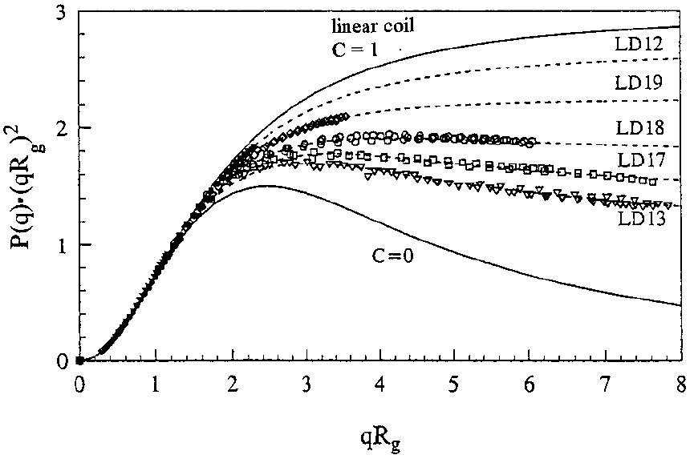
Details at higher q (smaller length scales) – Kratky Plot:
form factor fits:
C related to branching probability,
increases with molar mass

Slide 38
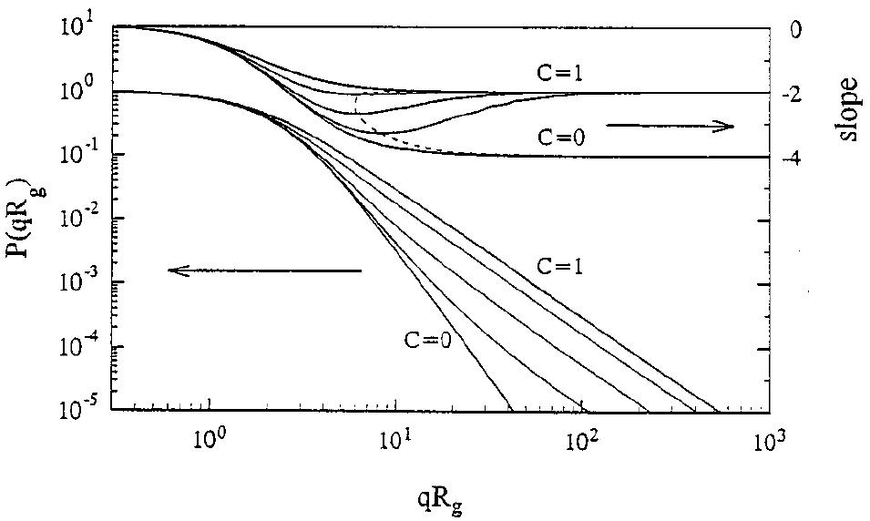
Are the starch samples, although not self-similar, fractal objects?
- minimum slope reached at qRg ≈ 10 (maximum q-range covered by SLS experiment !)
at higher q values (simulations or X-ray scattering) slope approaches -2.0
characteristic for a linear polymer chain (C = 1).
at very small length scale only linear chain sections visible (non-branched outer chains)

Slide 39
2. Pencer, J.;Hallett, F. R. Langmuir 2003, 19, 7488-7497
Samples:
uni-lamellar vesicles of lipid molecules 1,2-Dioleoyl-sn-glycero-3-phosphocholine (DOPC)
and 1-stearoyl-2-oleoyl-sn-glycero-3-phosphocholine (SOPC) by extrusion
Data Analysis:
monodisperse vesicles
thin-shell approximation
small values of qR, Guinier approximation

Slide 40
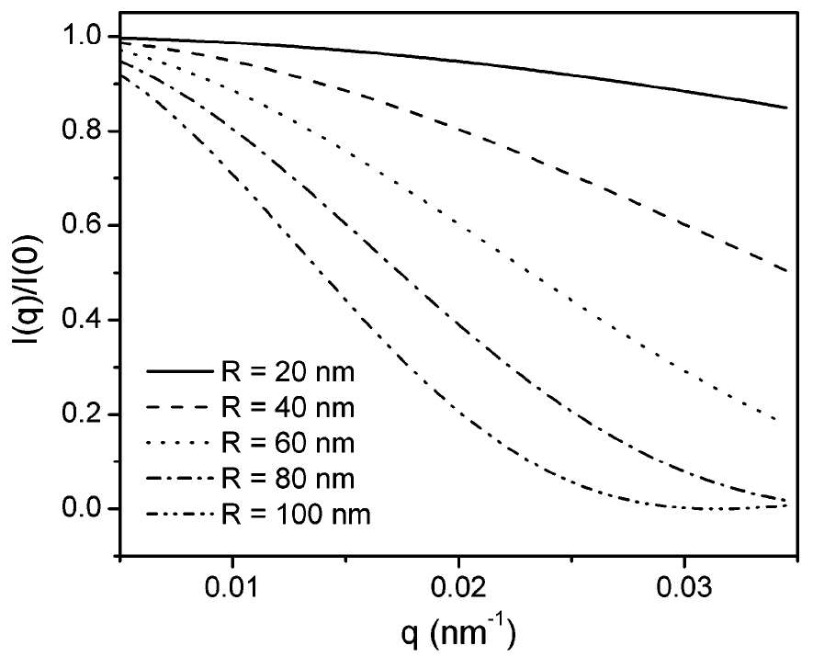
typical q-range of light scattering experiments: 0.002 nm-1 to 0.03 nm⁻¹
vesicles prepared by extrusion: radii 20 to 100 nm
=> first minimum of the particle form factor not visible in static light scattering

Slide 41
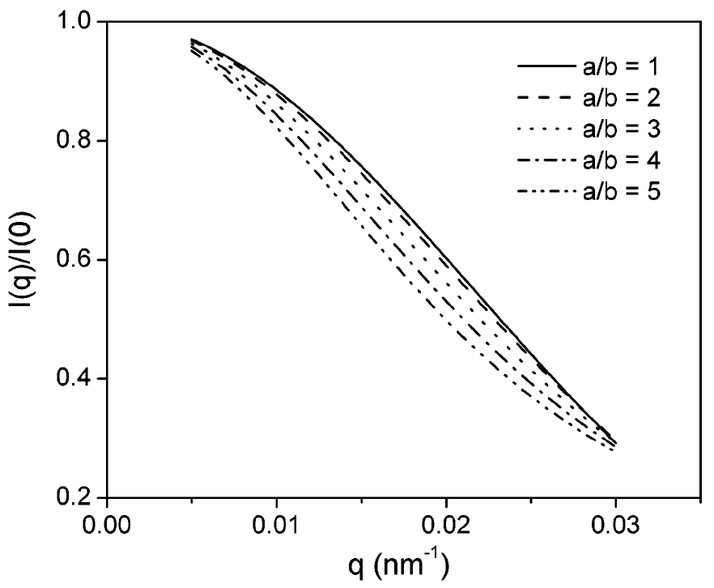
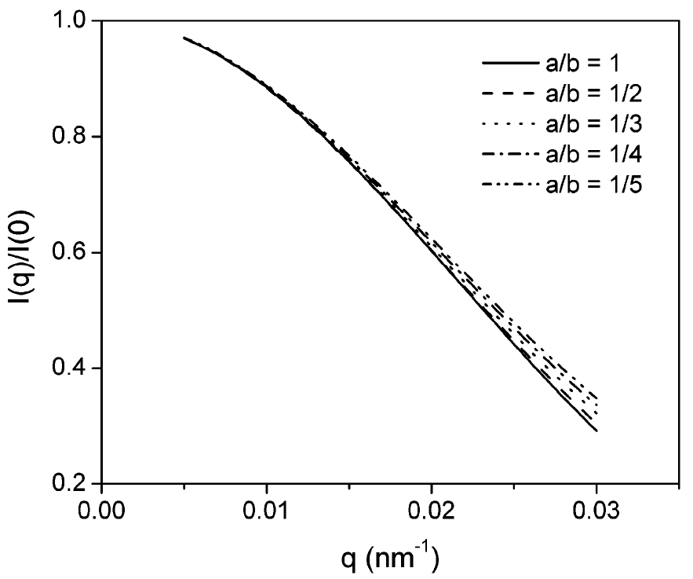
particle form factor of thin shell ellipsoidal vesicles, two symmetry axes (a,b,b)
prolate vesicles, surface area 4 π (60 nm)²
oblate vesicles, surface area 4 π (60 nm)²

Slide 42
anisotropy vs. polydispersity:
monodisperse ellipsoidal vesicles
polydisperse spherical vesicles
static light scattering from monodisperse ellipsoidal vesicles can formally be expressed
in terms of scattering from polydisperse spherical vesicles !
=> impossible to de-convolute contributions from vesicle shape and size polydispersity
using SLS data alone !
combination of SLS and DLS:
DLS: intensity-weighted size distribution => number-weighted size distribution (fit a,b) =>
SLS: particle form factor

Slide 43
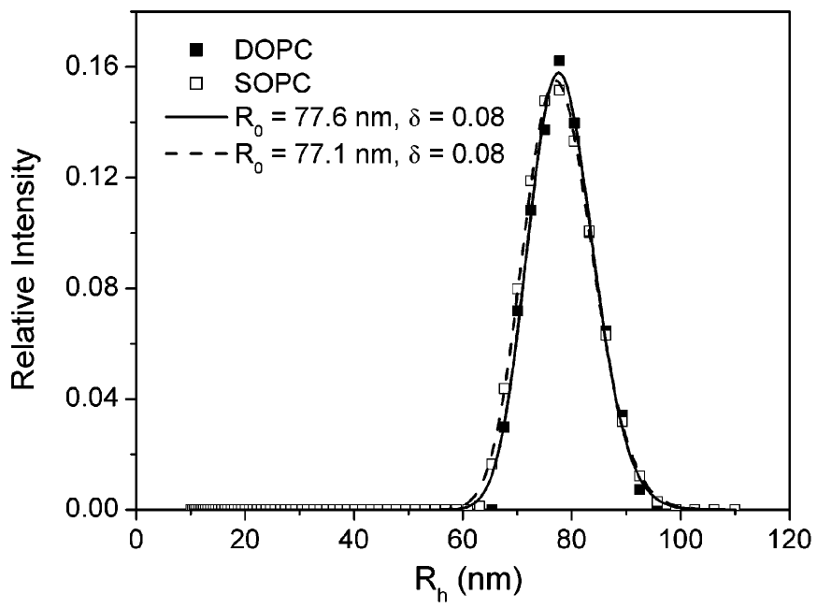
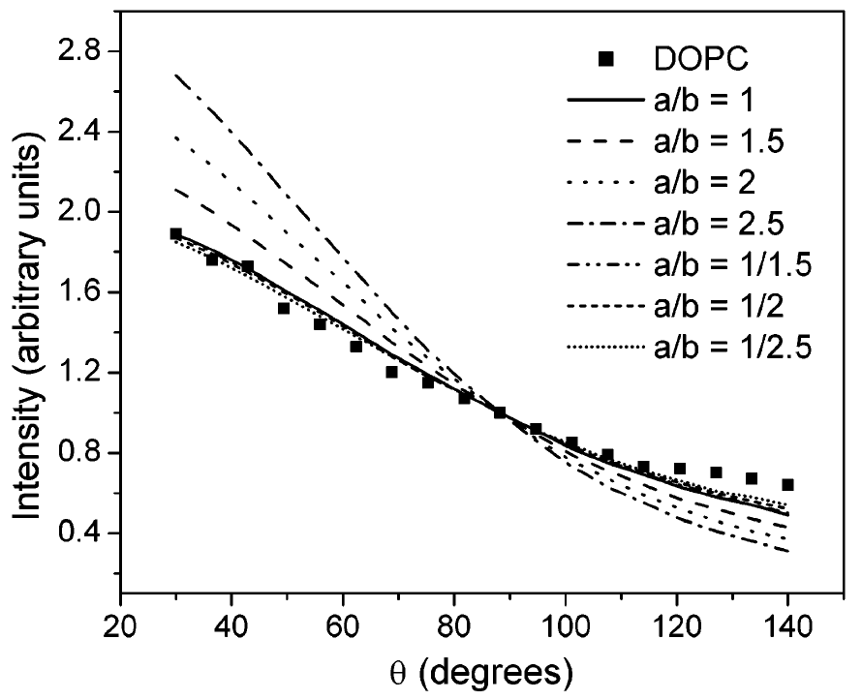
input for a,b – fits
to SLS data
,
result:
polydisperse (ΔR = 10%) oblate vesicles,
a : b < 1 : 2.5

Slide 44
3. Fuetterer, T.;Nordskog, A.;Hellweg, T.;Findenegg, G. H.;Foerster, S.;
Dewhurst, C. D. Physical Review E 2004, 70, 1-11
Samples:
worm-like micelles in aqueous solution, by association of the
amphiphilic diblock copolymer poly-butadiene(125)-b-poly(ethylenoxide)(155)
Analysis of SLS-results:
monodisperse stiff rods
asymmetric Schulz-Zimm distribution
polydisperse stiff rods
Koyama, flexible wormlike chains

Slide 45
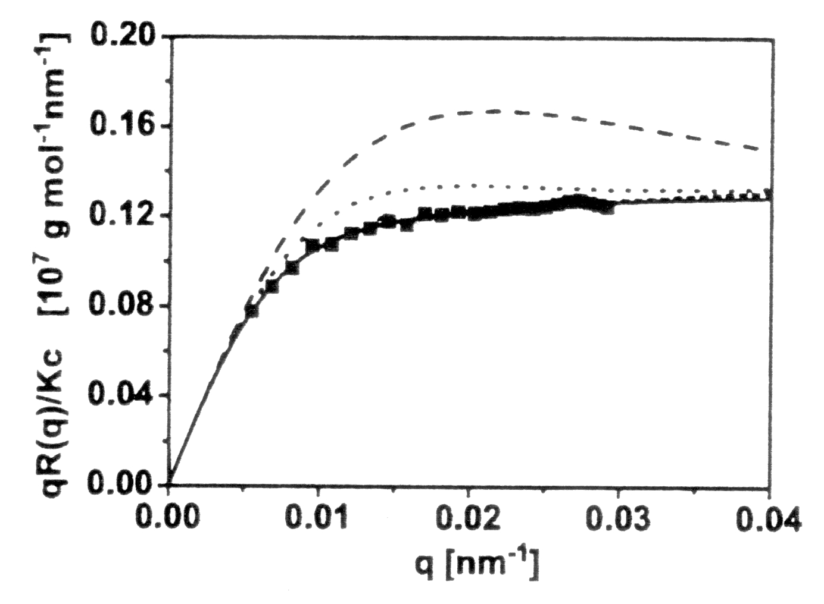
Holtzer-plot of SLS-data :
plateau value = mass per length of a rod-like scattering particle
fit results:
polydisperse stiff rods:
(ii) polydisperse wormlike chains:

Slide 46
Analysis of DLS-results:
amplitudes depend on the length scale of the DLS experiment:
- long diffusion distances (qL < 4): only pure translational diffusion S₀
- intermediate length scales (4 < qL < 15): all modes (n = 0, 1, 2) present
according to Kirkwood and Riseman:
polydispersity leads to an average amplitude correlation function!

Slide 47
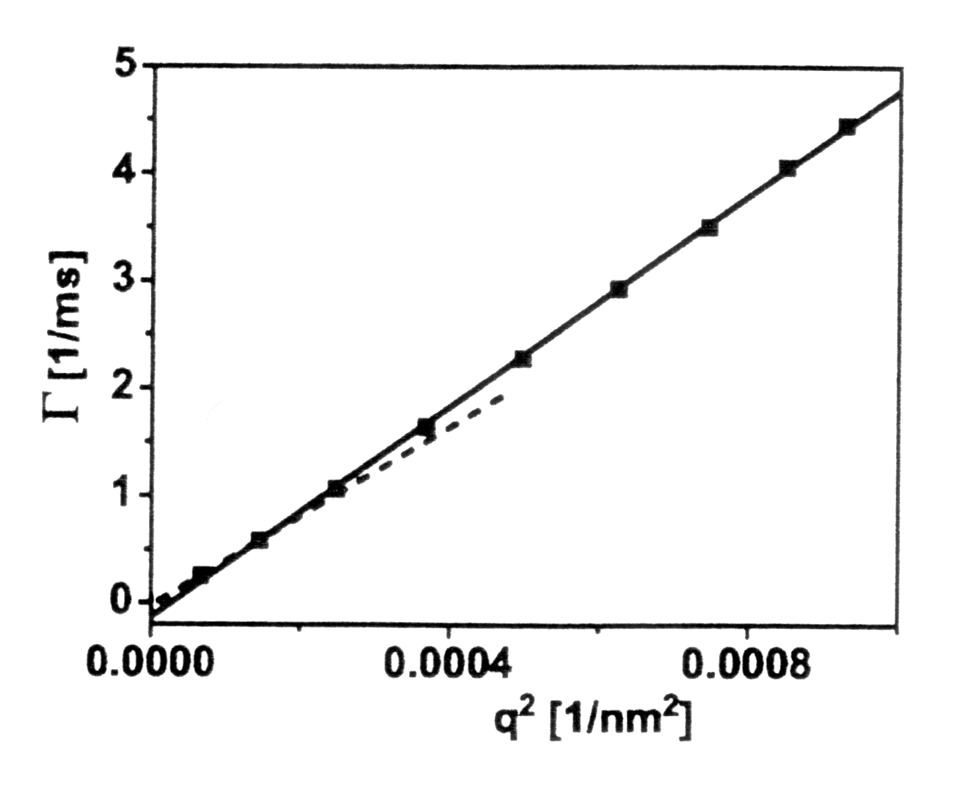
DLS relaxation rates :
linear fit over the whole q-range: significant deviation from zero intercept,
additional relaxation processes or “higher modes” at higher q
results:
Rg from Zimm-analysis and calculations!

Slide 48
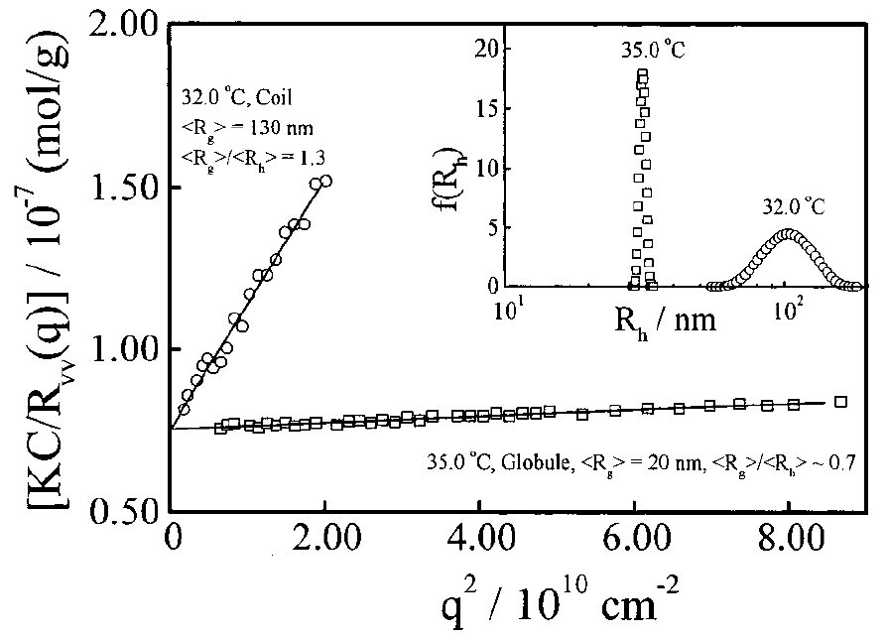
4. Wang, X. H.;Wu, C. Macromolecules 1999, 32, 4299-4301
samples:
high molar mass PNIPAM chains in (deuterated) water

Slide 49
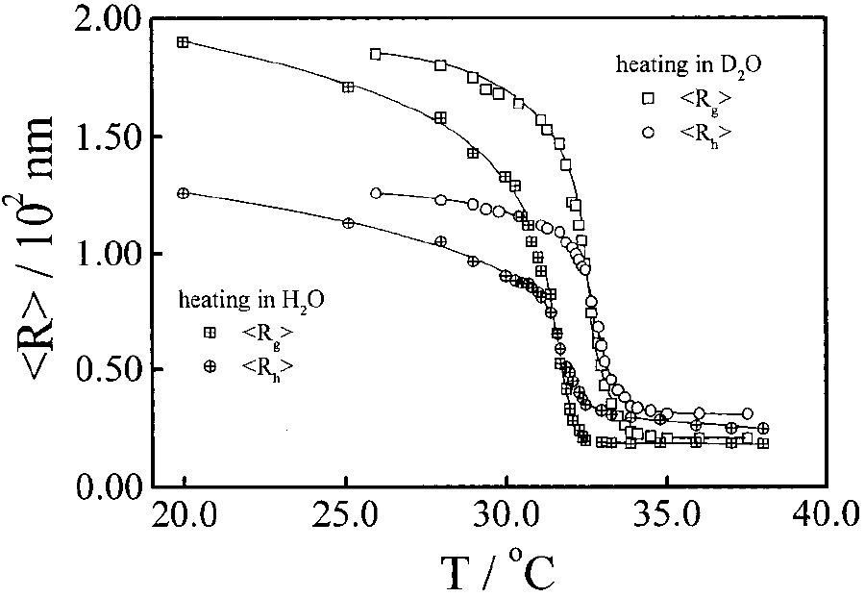
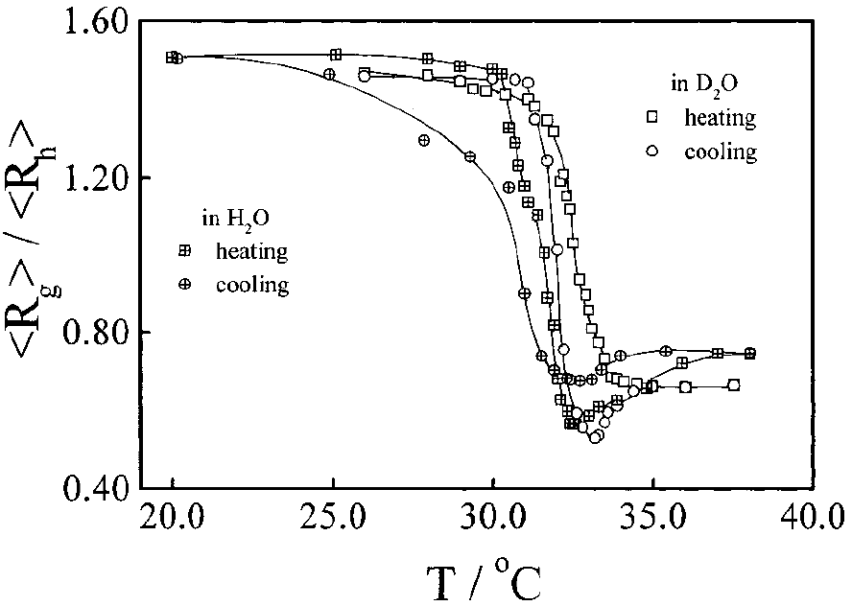
reversibility of the coil-globule transition:
molten globule ?
surface of the sphere has a lower
density than its center

Slide 50
Selected Examples – Static Light Scattering:
sample | problem | solution
branched polymeric nanoparticles | self-similarity (fractals) ?; | details at qR > 2 by Kratky plot (P(q) q² vs. q), fitting parameters for branched polymers, simulation of P(q) at qR > 10 (SLS: qR < 10) => not fractal !
vesicles (nanocapsules) | distinguish size polydispersity and shape anisotropy in P(q) ? | combine DLS (only size polydispersity !) and SLS to simulate expt. P(q)
worm-like micelles | characterization: length, R_{g}/R_{H} (R_{H}: no rotation-translation-coupling if qL < 4) | details at higher q by Holtzer plot (I(q) q vs. q), fit P(q), R_{g} from Zimm-analysis at small q values
PNIPAM chains in water at different T | coil – globule - transition | R_{g} from Zimm-analysis, R_{H} by DLS, decrease in R and R_{g} / R_{H}

Slide 51
3. Dynamic Light Scattering – Selected Examples
1. Vanhoudt, J.;Clauwaert, J. Langmuir 1999, 15, 44-57
sample: spherical latex particles in dilute dispersions
sample | s2 | s3 | s4 | s5 | s6 | s7
nominal diameter/nm | 19 | 54 | 91 | 19, 91 | 19, 54 | 54, 91
diameter ratio | - | - | - | 4.8 | 2.8 | 1.7
Data analysis of polydisperse samples:
1. Cumulant method (CUM), polynomial series expansion:
polydispersity index
particle diameter is a so-called harmonic z-average:
(only for homogeneous spheres)

Slide 52
2. non-negatively least squares method (NNLS):
M exponentials considered for the exponential series, yielding a set of coefficients b_{i}
defining the particle size distribution for decay rates equally distributed on a log scale.
3. Exponential sampling (ES):
See 2., decay rates chosen according to:
4. Provencher’s CONTIN algorithm:
Numerical procedure to calculate a continuous decay rate distribution B(Γ), also called
Inverse Laplace Transformation, enclosed in most commercial DLS setups.
5. double-exponential method (DE):

Slide 53
Results:
sample | s2 | s3 | s4 | s5 | s6 | s7
nominal diameter | 19 ± 1.5 | 54 ± 2.7 | 91 ± 3 | 19, 91 | 19, 54 | 54, 91
diameter ratio | - | - | - | 4.8 | 2.8 | 1.7
<d> - CUM (1.) | 20.3 | 55.0 | 87.0 | 36.9 | 29.5 | 69.0
PI – CUM (1.) | 0.029 | 0.009 | 0.008 | 0.248 | 0.191 | 0.069
d1,d2 – NNLS (2.) | - | - | - | 18, 81 | 16, 50 | -
d1,d2 – ES (3.) | - | - | - | - | 19, 54 | -
d1,d2 – DE (5.) | - | - | - | - | 18, 54 | -
Bimodal samples s5, s6, s7: I₁(q=0) = I₂(q=0)
Note: bimodal samples with d2/d1 < 2 (s7) beyond resolution of DLS !

Slide 54
2. van der Zande, B. M. I.;Dhont, J. K. G.;Bohmer, M. R.;Philipse, A. P.
Langmuir 2000, 16, 459-464
sample (TEM-results):
colloidal gold nanoparticles stabilized with poly(vinylpyrrolidone) (M = 40000 g/Mol)
system | length L [nm] | ΔL [nm] | diameter d [nm] | Δd [nm] | aspect ratio L/d
Sphere18 | 18 | 5 | - | - | -
Sphere15 | 15 | 3 | - | - | -
Rod2.6a | 47 | 17 | 18 | 3 | 2.6
Rod2.6b | 39 | 10 | 15 | 3 | 2.6
Rod8.9 | 146 | 37 | 17 | 3 | 8.9
Rod12.6 | 189 | 24 | 15 | 3 | 12.6
Rod14 | 283 | 22 | 20 | 3 | 14.0
Rod17.2 | 259 | 60 | 15 | 3 | 17.2
Rod17.4 | 279 | 68 | 16 | 3 | 17.4
Rod39 | 660 | 20 | 17 | 3 | 39.0
Rod49 | 729 | - | 15 | 3 | 49.0

Slide 55
DLS setup and data analysis:
Kr ion laser (647.1 nm far from the absorption peak of the gold particles (500 nm))
Measurements in vv-mode and vh-mode (depolarized dynamic light scattering DDLS)
(v = vertical, h = horizontal polarization)
intensity autocorrelation functions were fitted to single exponential decays,
including a second Cumulant to account for particle size polydispersity
vv-mode (only translation is detected):
depolarized dynamic light scattering (vh-mode)
(translation and rotation are detected, no coupling in case qL < 5)
translational diffusion coefficient D_{T} determined from the slope,
rotational diffusion coefficient D_{R} from the intercept
of the data measured in vh –geometry.

Slide 56
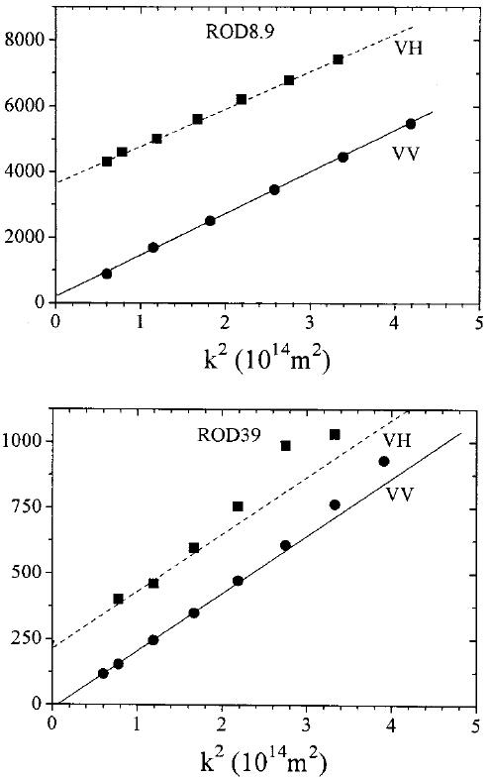
Results:
qL < 5
q² / 10¹⁴ m⁻²
q_{max}L > 5 (≈ 9) !
q² / 10¹⁴ m⁻²

Slide 57
diffusion coefficients according to Tirado and de la Torre,
using as input parameters length and diameter from TEM
system | 10⁻¹² D_{T}, exp [m²s⁻¹] | 10⁻¹² D_{T}, calc [m²s⁻¹] | D_{R}, exp [s⁻¹] | D_{R}, calc [s⁻¹]
Rod8.9 | 6.0 | 8.4 | 306 | 2238
Rod12.6 | 4.9 | 7.4 | 281 | 1258
Rod14 | 2.9 | 5.2 | 66 | 396
Rod17.2 | 4.0 | 6.0 | 177 | 563
Rod17.4 | 3.5 | 5.6 | 175 | 452
Rod39 | 1.2 | 2.9 | 14 | 46
Rod49 | 0.7 | 2.8 |  | 30
values determined by DDLS systematically too small, because PVP-layer
(thickness 10 – 15 nm) not visible in TEM !

Slide 58
Selected Examples – Dynamic Light Scattering:
sample | problem | solution
bimodal spheres | size resolution | - double exponential fits - size distribution fits - CONTIN ; only if R₁/R₂ > 2
stiff gold nanorods | length and diameter in solution =?; deviation TEM – DLS ? | depolarized DLS (vh) => D_{rot} standard DLS (vv) => D_{trans}; deviation TEM-DLS due to PVP stabilization layer

