Slide 1
Design and Application of Modern Heuristics
Mainz, September 2012
Franz Rothlauf
TexPoint fonts used in EMF.
Read the TexPoint manual before you delete this box.: AAAAAAAAA

Slide 2
These slides have been the basis for a class on the design and application of modern heuristics given at the university of Mainz in fall 2012
The slides are based on the book "Design of Modern Heuristics" published at Springer
You are free to use the material contained in these slides for your own classes or presentations. A reference to the book would be nice.
Many thanks to Jörn Grahl who contributed to preparing the slides. For editing some of the latex displays, we used texpoint.
Enjoy modern heuristics!

Slide 3
Agenda
Modern Heuristics (10)
  Heuristics
  Approximation Algorithms (20)
  Modern (Meta) Heuristics (27)
Optimization Problems (37)
  Prerequisites
    Search Spaces
    Fitness Landscapes
  Problem Complexity (54)
  No-Free Lunch Theorem (77)
  Locality (84)
    Fitness distance correlation
    Ruggedness
  Decomposability (102)
Representations (115)
  Introduction
  Design Guidelines for Representations (138)
  Properties of Representations
    Locality (147)
    Redundancy (161)
Search Operators (189)
  Design Principles
  Standard Search Operators (199)
Fitness Function (206)
  Design Guidelines
  Examples
Initialization (216)
Search Strategies (220)
  Diversification and Intensification
  Variable Neighborhood Search (228)
  Pilot Method (233)
  Evolution Strategies (237)
  Genetic Algorithms (244)
Design Principles (252)
  High Locality
  Bias

Slide 4
Intro
Round of introductions
Purpose of class
Organisational Issues

Slide 5
Grading and Participation
First two days: Lecture
Third day: Problem presentations and discussion of particular problems (see workshop literature)
Fourth day: Discussion and Development of enhanced methods

Slide 6
Class Background Literature
Rothlauf, F. (2011): Design of Modern Heuristics: Principles and Application. Springer, Berlin
2.1 Kallel, L.; Naudts, B.; Reeves, C. R. (2001): Properties of fitness functions and search landscapes. Theoretical aspects of Evolutionary Computing 2001, Springer, London, 175-206.
2.2 He, J.; Reeves, C.; Witt, C.; Yao, X. (2007): A Note on Problem Difficulty Measures in Black-Box Optimization: Classification, Realizations and Predictability. Evolutionary Computation 15(4): 435-443.
2.3
  Wolpert, D. H.; Macready, W. G. (1997): No Free Lunch Theorems for Optimization. IEEE Transactions on Evolutionary Computation 1(1): 67-82.
  Christensen, S.; Oppacher, F. (2001): What can we learn from No Free Lunch? A first attempt to characterize the concept of a searchable function. Proceedings of the Genetic and Evolutionary Computation Conference 2001, Morgan-Kaufman, San Francisco CA, 1219-1226.
  Koehler, G. J. (2007): Conditions that obviate the No Free Lunch Theorem. INFORMS Journal on Computing 19(2): 273-279
5. Coello Coello, C. A. (2002): Theoretical and numerical constraint-handling techniques used with evolutionary algorithms: A survey of the state of the art. Computer methods in applied mechanics and engineering (191) 2002: 1245-1287.
7.
  Blum, C.; Puchinger, J.; Raidl, G.; Roli, A. (2011): Hybrid metaheuristics in combinatorial optimization: A survey. Applied Soft Computing 11 (2011) 4135-4151.
  Blum, C.; Roli, A. (1993): Metaheuristics in Combinatorial Optimization: Overview and Conceptual Comparison. ACM Computing Surveys 35(3): 268-308.

Slide 7
Selected Workshop Literature
Debels, D.; Vanhoucke, M. (2007): A Decomposition-Based Genetic Algorithm for the Resource-Constrained Project-Scheduling Problem. In: Operations Research 55 (3), S. 457–469.
Ropke, S.; Pisinger, D. (2006): An Adaptive Large Neighborhood Search Heuristic for the Pickup and Delivery Problem with Time Windows. In: Transportation Science 40 (4), S. 455–472.
Schittekat, P.; Sorensen, K. (2009): OR Practice--Supporting 3PL Decisions in the Automotive Industry by Generating Diverse Solutions to a Large-Scale Location-Routing Problem. In: Operations Research 57 (5), S. 1058–1067.
Sung-Soon Choi; Byung-Ro Moon (2008): Normalization for Genetic Algorithms With Non-synonymously Redundant Encodings. In: IEEE Transactions on Evolutionary Computation 12 (5), S. 604–616.

Slide 8
Background
Performing Experimental Studies
Bartz-Beielstein, T. (2006): Experimental Research in Evolutionary Computation - The New Experimentalism. Springer-Verlag, Berlin, Heidelberg, New York.
Publishing: what and how?
Schrader, U.; Hennig-Thurau, T. (2009): VHB-JOURQUAL2: Method, Results, and Implications of the German Academic Association for Business Research's Journal Ranking. BuR - Business Research 2(2): 180-204.
Writing a Review:
Lee, A. S. (1995): Reviewing a manuscript for publication. Journal of Operations Management 13 (1995) 87-92.

Slide 9
left intentionally blank

Slide 10
Modern Heuristics
Heuristics
  Construction Heuristics
  Improvement Heuristics
Approximation Algorithms
Modern Heuristics (Metaheuristics)

Slide 11
History
Modern Heuristics
Until 1970s: mostly exact optimization
Many practical problems are NP-complete
→ exact approaches have exponential running time
Idea: relax optimality, increase efficiency
→ Heuristics

Slide 12
Construction heuristics
Modern Heuristics - Heuristics
A.k.a. single-pass heuristics
Build solution from scratch
  Several steps
  Fix one part of solution per step
  Often: fix one decision variable per step
Terminate when solution is complete
No improvement steps

Slide 13
Improvement heuristics
Modern Heuristics - Heuristics
Start from a complete solution
Improve solution
  Several steps
  Possible changes define a „neighborhood“
  No diversification: objective value increases
  If no improvement is possible: terminate

Slide 14
Greedy search
Modern Heuristics - Heuristics
Construction & improvement heuristics
are often greedy
Choose alternative with highest objective value
No looking ahead, myopic, fast, sub-optimal

Slide 15
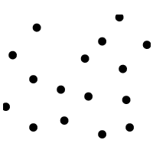
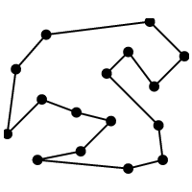
Example: Travelling salesman problem
Modern Heuristics - Heuristics
Connect n cities with minimal total distance
Data Optimal solution
node location
distance weights
path

Slide 16
Construction heuristics for TSP (1)
Modern Heuristics - Heuristics
Nearest neighbor (Rosenkrantz et al, 1977)
  Start with random city
  Connect nearest unconnected city
  Terminate when all cities are connected
  Although an upper bound
  exists on solution quality, it does not perform
  well in practice

Slide 17
Construction heuristics for TSP (3)
Modern Heuristics - Heuristics
Nearest insertion
  Start with a random two-city tour
  Select city with minimal distance to any connected city
  Add city in a way that minimizes increase of tour length
  Worst case performance:
Cheapest insertion
  Like nearest insertion, but chooses city that increases tour length the least
  Worst case performance:

Slide 18
Construction heuristics for TSP (3)
Modern Heuristics - Heuristics
Furthest insertion
  Start with longest two-city tour
  Iteratively add city that increases tour length the most when inserted it in the best position on the current tour
  Idea: start with cities that are far apart
  Worst-case performance is
  (like cheapest insertion), but furthest insertion outperforms the other construction heuristics in practice.

Slide 19
Improvement heuristics for TSP (1)
Modern Heuristics - Heuristics
Two-opt
  Remove any two possible edges and obtain two subtours. Insert two new edges such that resulting tour length is minimal.
  If distances are Euclidean, no edges in resulting tour do cross (on-crossing tour)
  Worst case performance
k-opt (Lin, 1965)
  Generalization of 2-opt. Examine some or all -subsets of edges in a tour
  If exchange of k edges does not improve tour, tour is k-optimal
  If triangle inequality holds, worst case performance of
  k-opt is (Chandra et al, 1994)

Slide 20
Approximation Algorithms
Modern Heuristics - Approximations
Heuristics substitute optimality by tractability
Approximation algorithms are heuristics with a quality bound
Performance is measured by approximation ratio
n is problem size, x^{approx} is solution returned by algorithm, and x* is optimal solution
Definition holds for minimization and maximization
Notes:
rho (n)

Slide 21
Understanding approximation ratio
Modern Heuristics - Approximations
An algorithm has an approximation ratio ½(n)
if for any input size n the objective value of the returned solution is within a factor of ½(n) of the
optimal objective value.
If an algorithm always returns the optimum ½(n)=1
If algorithm returns solution that is never worse than 2f*, then ½(n)=2

Slide 22
Trade-off between effort and quality
Modern Heuristics - Approximations
Some approximation algorithms can achieve increasingly smaller approximation ratios ½(n)! 1 by using more and more computation time.
We call them approximation schemes
Required input : ²
Approximation schemes return for any fixed ² >0 a solution with approximation ratio 1+²

Slide 23
Fully polynomial-time approx. scheme
Modern Heuristics - Approximations
FPAS, FPTAS
Returns a solution with approximation ratio (1+²)
Running time is polynomial in both input size n and 1/²
Fast for small ² and large n
Allows effective problem solving

Slide 24
Polynomial-time approx. scheme
Modern Heuristics - Approximations
PAS, PTAS
Returns a solution with approximation ratio of (1+²)
Running time polynomial in input size n
However, running time can grow exponentially in 1/²
Fast for large n but not for small ²

Slide 25
Constant-factor approximations
Modern Heuristics - Approximations
APX
Guarantee a constant-factor approximation ratio
Approximation ratio is fixed, not a parameter
Running time is polynomial in problem size n

Slide 26
Approximation and complexity
Modern Heuristics - Approximations
FPTAS are most effective, followed by PTAS and APX
Introduce new complexity classes
Problems in P can be solved in polynomial time
Problems in NP require exponential time
Problem is PTAS-hard if no FPTAS exists
Problem is APX hard if no PTAS exists

Slide 27
Modern heuristics
Modern Heuristics – Modern Heuristics
Extended variants of improvement heuristics, „metaheuristics“
Modern heuristics
  Can be applied to a wide range of problems
  Use intensification (exploitation) and diversification (exploration) steps
Intensification steps shall improve quality
Diversification explores new areas of search space, also accepting complete or partial solutions that are inferior to current solution

Slide 28
Principles (1)
Modern Heuristics – Modern Heuristics
Start with one or more random solutions
In iterative steps modify solution(s) to generate one or more new solution(s)
New solutions are created by search operators (variation operators)
Regularly perform intensification and exploration phases
  During intensification, it uses objective function values and focuses variation on high-quality solutions
  During diversification, usually objective function values are not considered. Modify solutions such that new areas of search space are explored.

Slide 29
Principles (2)
Modern Heuristics – Modern Heuristics
Modern heuristics perform a limited number of search steps
To be applicable, two requirements must be met
  Representation: We must be able to represent complete solutions so that variation operators can be used.
  Pair wise fitness comparisons must be possible, indicating which of two solutions is better.

Slide 30
Design elements of Modern Heuristics
Modern Heuristics – Modern Heuristics
Representation
Variation operators
Fitness function
Initial solution(s)
Search strategy
Can be addressed to build a new heuristic and to categorize existing ones
Central to this course

Slide 31
Example: Simulated Annealing (SA)
Modern Heuristics – Modern Heuristics
Local search that accepts inferior solutions to escape from local optima
Probability of accepting inferior solution depends on solution quality; it decreases during run.
Analogy from cooling metals or liquids

Slide 32
Simulated Annealing
Modern Heuristics – Modern Heuristics
Uses iterative steps
In each step: apply variation operator(s) to current solution xº , obtain new solution x^{n}
Accept x^{n} with probability
Temperature T is a strategy parameter
±E is the fitness difference

Slide 33
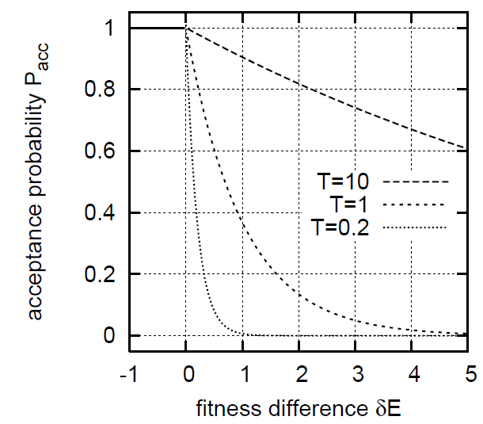
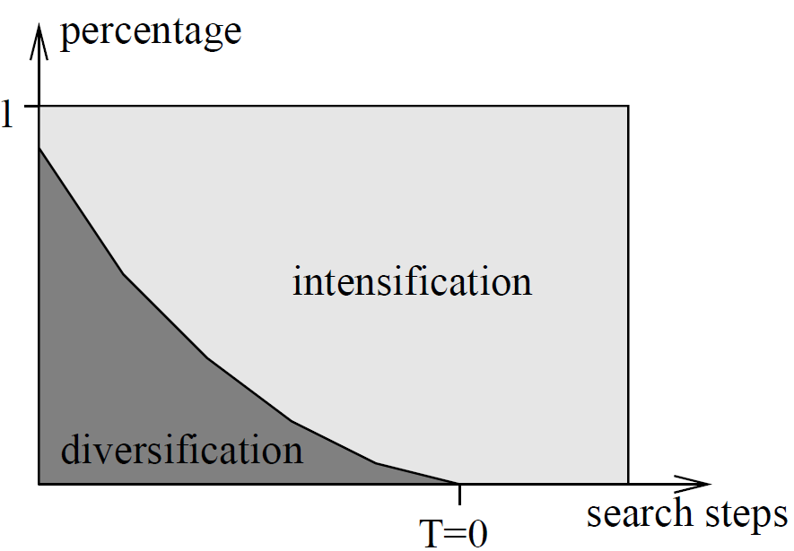
Diversification and intensification
Modern Heuristics – Modern Heuristics
For T! 0, SA becomes local search
Probability of accepting inferior solution decreases with fitness difference

Slide 34
Getting the cooling schedule right
Modern Heuristics – Modern Heuristics
If T is reduced very slowly, SA returns optimal solution; however resulting runtime is prohibitive
If T is reduced too fast, SA converges to local optimum.
Often a fixed schedule is used where T_{i+1}=cT_{i} (0<c<1) and c2[0.9, 0.999]
T₀ ¼ ¾(f(x)) … 2¾(f(x)), where ¾(f(x)) is the standard deviation of objective function values of randomly generated solutions.

Slide 35
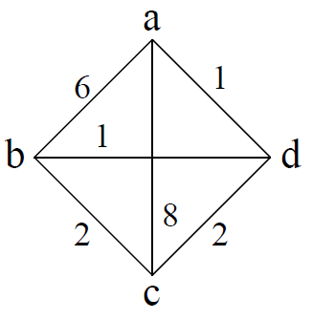
Example: SA for the TSP (1)
Modern Heuristics – Modern Heuristics
Representation: sequence of cities
a is starting city
Two solutions x,y are neighbors if Hamming distance d(x,y)=2.
Three solutions: adbca (12), abdca (17), adcba (11)
Linear cooling schedule T_{i+1} = 0.9T_{i}

Slide 36
Example: SA for the TSP (2)
Modern Heuristics – Modern Heuristics
Start with initial solution x⁰=abcda, f(x⁰)=11
Variation operator randomly exchanges the position of two cities in tour
New solution: x¹ = abdca, f(x¹) = 17
Replace x⁰ with x¹ with probability P=exp(-6/3)¼ 0.14
Generate uniform random number rnd=[0,1) and if
rnd<0.14 replace old solution, otherwise continue with x⁰.
Then, reduce the temperature: T₁ = 2.7
Continue until a time limit reached or no improvement for some number of steps.

Slide 37
2. Optimization Problems
Prerequisites
  Search Spaces
  Fitness Landscapes
Problem Complexity
No-Free Lunch Theorem
Locality
  Fitness distance correlation
  Ruggedness
Decomposability

Slide 38
Search spaces
Optimization Problems - Prerequisites
For formulating optimization models, we need a set of (feasible) solutions
This set defines a search space X
The search spaces "contains"
  possible solutions of a problem and
  relations between the different solutions

Slide 39
(Topological space)
Optimization Problems - Prerequisites
Very general, a search space can be defined as a topological space
A topological space is defined as a set X of decision alternatives together with a collection of subsets of X called open sets such that
  the empty set ; and whole space X are open sets,
  the intersection of a finite number of open sets is also an open set, and
  the union of an arbitrary number of open sets is an open set.
  A set Y is a subset of a set X (denoted as Y ½ X) if every element 2 Y is also in X (x2 Y ! x2 X)
To define a topological space, we need no definition of similarity between elements in a search space.

Slide 40
Metric search spaces
Optimization Problems - Prerequisites
Common topological space where similarity between elements can be measured using some kind of metric
We have a set X of solutions and a real-valued distance function (also called a metric)
assigning a real-valued distance to any pair x,y 2 X . It is required, that for any x,y,z 2 X:

Slide 41
City-block metric (Manhattan metric)
Optimization Problems - Prerequisites
For x,y2R, define distance d(x,y) = |x-y|
Extending to two dimensions: city-block metric (also known as Manhattan distance)
d(x,y) = |x₁ -y₁| + |x₂ -y₂|
where x =(x₁ ,x₂), y=(y₁, y₂).
In n dimensions, the metric becomes

Slide 42
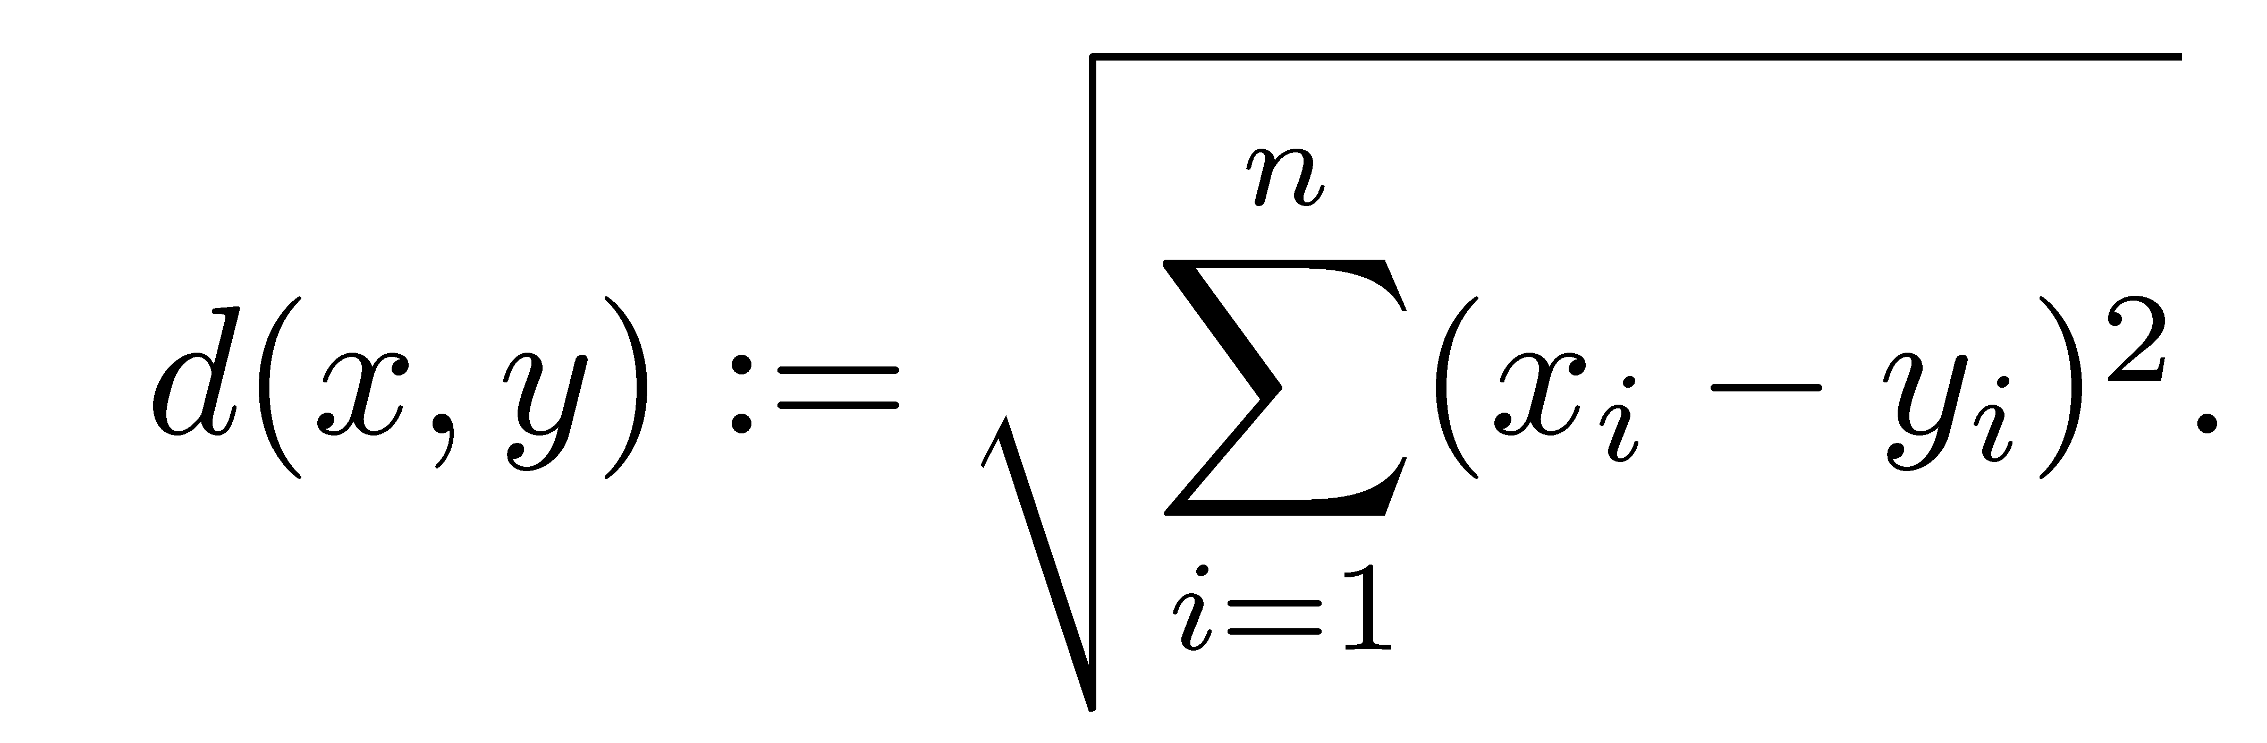
Euclidean metric
Optimization Problems - Prerequisites
Solutions are vectors of continuous variables
x=(x₁ , x₂ , …, x_{n} ), x_{i} 2 R
Euclidean distance between x and y is
For n=1: city-block metric, n=2: standard straight line distance between two points on a 2d-plane

Slide 43
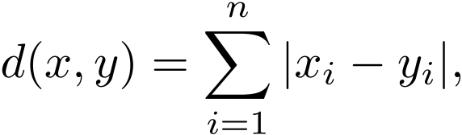
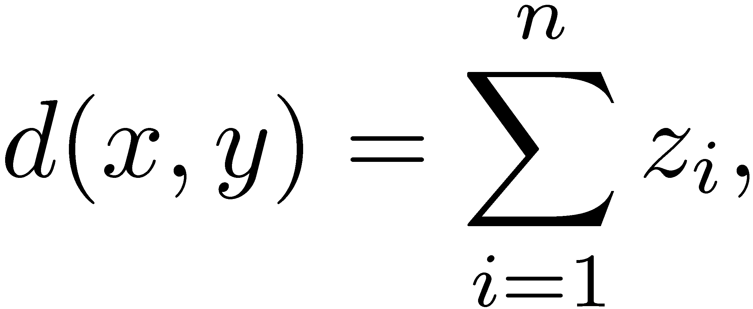
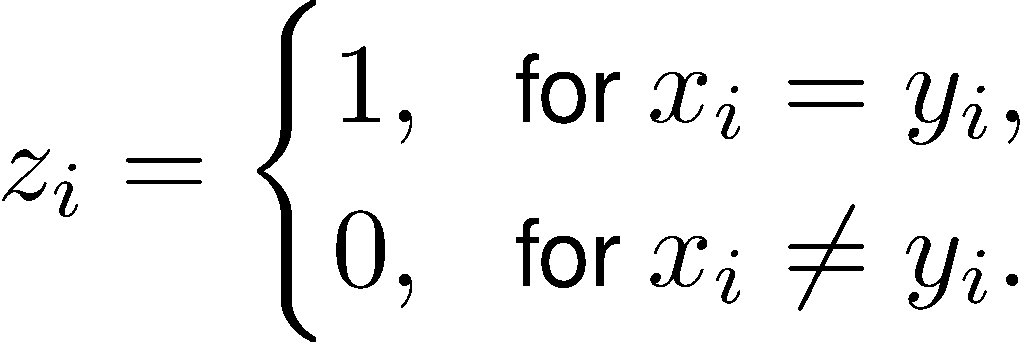
Hamming metric
Optimization Problems - Prerequisites
Often used for binary search spaces; counts number of items that are not identical
where d(x,y)2{0,…,n}.
Binary Hamming metric can be extended to continuous and discrete decision variables:
where

Slide 44
Neighborhoods
Optimization Problems - Prerequisites
2. Search Spaces
On metric search spaces, we can define similarities between solutions based on the used distance d.
Neighborhoods determine which solutions are similar to each other with respect to some metric.
A neighborhood is a mapping N(x): X ! 2^{x}
where X is the search space, 2^{x} is the set of all possible subsets of X and N is a mapping that assigns to each element x2X a set of elements y2X .
Usually a neighborhood definition assigns to each solution x2X a set of solutions y that are similar to x in some sense.

Slide 45
Euclidean Neighborhoods
Optimization Problems - Prerequisites
2. Search Spaces
We define a neighborhood for a 2-dimensional continuous search space and Euclidean distances.
All solutions y, where d(x,y) <² are neighboring solutions to x
All neighboring solutions can be found inside a circle around x with radius ².
Notes:
Immer als cgm exportieren.

Slide 46
City-Block Neighborhoods
Optimization Problems - Prerequisites
2. Search Spaces
We define a neighborhood for a 2-dimensional continuous search space and city-block distances.
All solutions inside a rhombus with the vertices (x₁-²,y₁), (x₁,y₁+²), (x₁+²,y₁), (x₁,y₁-²) are neighboring solutions.
Notes:
Immer als cgm exportieren.

Slide 47
Neighborhoods
Optimization Problems - Prerequisites
2. Search Spaces
Defining a proper neighborhoods is difficult
Example:
  A user can choose from four fruits. These four decision alternatives can be modeled using a metric search space X={0,1}². Each solution ((0,0), (0,1),(1,0), (1,1)) represents one type of fruit.
  Although no similarities are defined for the different fruits, the use of a binary search space induces that the solution (0,0) is more similar to (0,1) than to (1,1) (using Hamming distance).
  Therefore, this problem space is inappropriate for the problem definition as it defines similarities where no similarities exist.
  A more appropriate model would be x2{0,…3} and using Hamming distance. Then, all distances between the different solutions are equal and all solutions are neighboring solutions (for ²=1).

Slide 48
Neighborhoods
Optimization Problems - Prerequisites
2. Search Spaces
Definition and use of decision variables naturally leads to a metric.
If metric induced by decision variables does not fit to the metric of the problem description, the model is inappropriate.
If a metric used in problem definition does not fit to the metric used in the model, similarities between different decision alternatives do not match the similarities between different solutions described by the model.

Slide 49
Neighborhoods: Example
Optimization Problems - Prerequisites
2. Search Spaces
Nine different decision alternatives {a, b, c, d, e, f, g, h, i}. An objective value is assigned to each decision alternative. We assume that the decision alternatives form a metric space using the city-block metric, where the distances between all elements are equal. Therefore, all decision alternatives are neighbors (for ² =1).
Model 1: We use a metric space X={0,1,2}² and the city-block metric. Therefore, each decision alternative is represented by x=(x₁,x₂), where x_{i}2{0,1,2}. Two solutions are similar to each other if the decision variables have the same values (e.g. solution (1,1) is more similar to (1,2) than to (2,2)). For ² =1, each solution has either three or four neighbors. Consequently, our neighborhood differs from the original problem.
Model 2: We use binary variables x_{ij} and the search space is defined as X=x_{ij}, where x_{ij}2{0,1}. We have an additionial restriction, ∑_{j} x_{ij}=1, where i2{1,2} and j2{1,2,3}. Again, Hamming distance can be used. For ²=1, no neighboring solutions exist. For ²=2, each solution has only two neighbors.
We see that different models for the same problem result in different neighborhoods which do not coincide with the neighborhoods of the original problem.

Slide 50
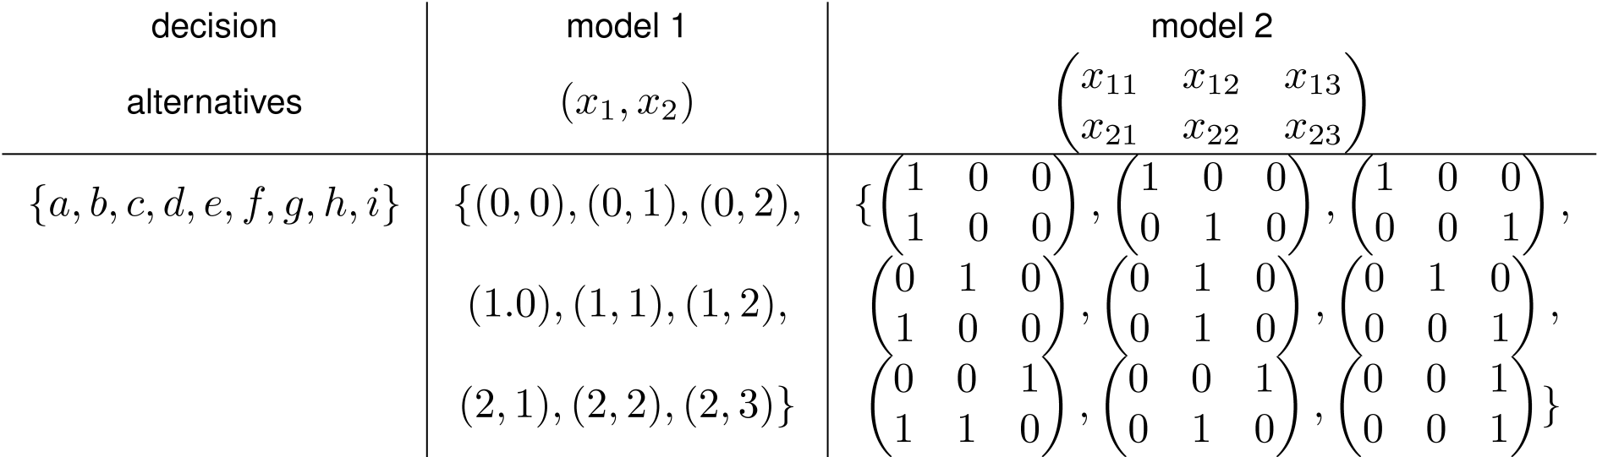
Neighborhoods: Example
Optimization Problems - Prerequisites
2. Search Spaces
Different search spaces result into different problems

Slide 51
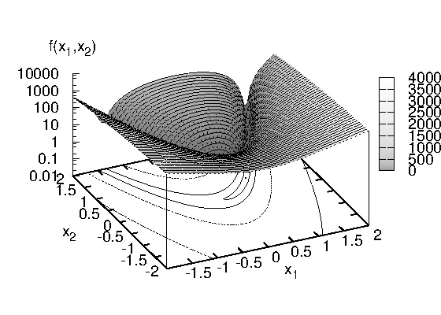
Fitness Landscapes (1)
Optimization Problems - Prerequisites
2. Search Spaces
For combinatorial search spaces where a metric is defined, we can introduce the concept of fitness landscape.
A fitness landscape (X,f,d) of a problem instance consists of
  a set of solutions x2 X,
  a distance measure d,
  and an objective function f
  that measures the quality
  of each solution.

Slide 52
Fitness Landscapes (2)
Optimization Problems - Prerequisites
d_{min}=min_{x,y2 X}(d(x,y)) is the minimum distance between two elements x and y of a search space.
Two solutions x and y are denoted as neighbors if d(x,y)=d_{min}.
Often, d_{min}=1.
The fitness landscape can be described as a graph G_{L} with a vertex set V=X and an edge set E={(x,y)2 S£S | d(x,y)=d_{min}}.
The distance between two solutions x,y2 X is proportional to the number of nodes that are on the path of minimal length between x and y in the graph G_{L}.

Slide 53
Fitness Landscapes and Optimal Solutions
Optimization Problems - Prerequisites
2. Search Spaces
We have a one-dimensional minimization problem. Independently of the used neighborhood, u is the global optimum.
If we use the 1-dimensional Euclidean distance as metric, we can define a neighborhood around x as N(x)={y|y2X ,d(x,y) · ²}. The solution v is a local optimum if ²<d₁ .
Analogously, w is a local optimum for all neighborhoods with ²<d₂ .
For ²¸ d₂ , the only locally optimal solution is the global optimal solution u.

Slide 54
Intro: What are difficult problems?
Optimization Problems – Problem Complexity
3. Problem Difficulty
Two different questions:
  How difficult is a problem?
    Equivalent to "What is the complexity of the best-performing algorithm that can solve this problem?
    Complexity classes
  How well can a problem be solved using optimization method xyz?
    Is optimization methods xyz the right one?
    No-free lunch theorem

Slide 55
Example: Random Search
Optimization Problems – Problem Complexity
3. Problem Difficulty
Functionality
  New solutions are chosen randomly and no prior information about the structure of the problem or previous search steps is used.
  All possible optimization problems have the same difficulty
There are no easy or difficult problems for random search.
Number of fitness evaluations for finding the optimum is independent from optimization problem (if optimum is unique).

Slide 56
Difficult Problems (Problems closed under permutation)
Optimization Problems – Problem Complexity
3. Problem Difficulty
Problems, where no meaningful metric can be defined/exists
  Examples:
    Finding largest value in unordered sequence
    Finding largest value in white noise
  We have a set of solutions x2 X with objective values f(x).
  No metric is defined: search algorithms do not “know” how to guide the search through the search space
  Can only be solved by to iteratively examining all elements of search space, returning the best found solution
  All optimization methods that can be applied to such problems behave like random search
  The difficulty of such problems (O(|X|)) is independent of used optimization algorithm.

Slide 57
Complexity of Problems and Algorithms
Optimization Problems – Problem Complexity
3. Problem Difficulty – Problem Complexity
The complexity of a problem is the effort that is necessary to solve the problem.
It is possible to define upper and lower bounds on problem difficulty.
Lower bounds tell us that a problem has at least this problem difficulty whereas upper bound limit problem difficulty from above.
Complexity of problems is closely related to the complexity of algorithms.

Slide 58
Complexity of Problems and Algorithms
Optimization Problems – Problem Complexity
3. Problem Difficulty – Problem Complexity
Upper bounds on problem difficulty:
We can find upper bounds on problem difficulty
Based on the complexity of algorithms
If an algorithm can solve a problem, an upper bound on the difficulty of the problem is the complexity of the algorithm.
Example:
We study the problem of finding a friend's telephone number in the telephone book. The most straightforward approach is to search through the whole book starting from ‘A’. Effort O(n). Therefore, we have an upper bound on problem complexity (linear) as we know a linear algorithm that can solve the problem. A more effective way to solve this problem is bisection which iteratively splits the entries of the book in halves. With n entries, we only need log(n) search steps to find an address. So, we have a new, improved, upper bound on problem difficulty.

Slide 59
Complexity of Problems and Algorithms
Optimization Problems – Problem Complexity
3. Problem Difficulty – Problem Complexity
Lower bounds on problem complexity
Finding lower bounds on problem difficulty is more difficult
We have to show that no algorithm exists that needs less effort to solve the problem.
Optimization problems where no metric is defined can only be solved when examining all available solutions.
Therefore, we have a lower bound on problem difficulty as the effort of algorithms to solve such problems increases at least linearly with the size of the search space.
The lower bound must hold for all possible algorithms that can be used to solve the problem.
A problem is denoted to be closed if the upper and lower bound on its problem difficulty are identical.

Slide 60
Formulating Complexity: Landau notation
Optimization Problems – Problem Complexity
3. Problem Difficulty – Problem Complexity
Landau notation can be used to compare asymptotic growth of functions
Helpful when measuring the complexity of problems or algorithms.
Allows to formulate asymptotic upper and lower bounds on function values.

Slide 61
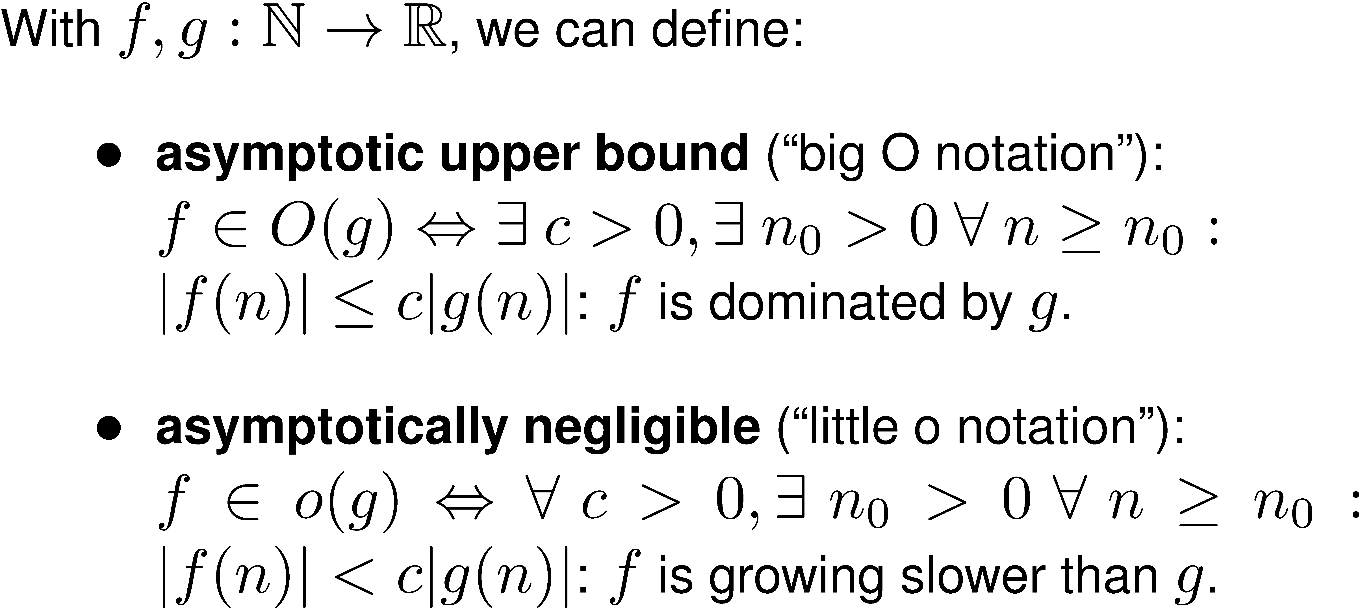
Landau notation
Optimization Problems – Problem Complexity
3. Problem Difficulty – Problem Complexity

Slide 62
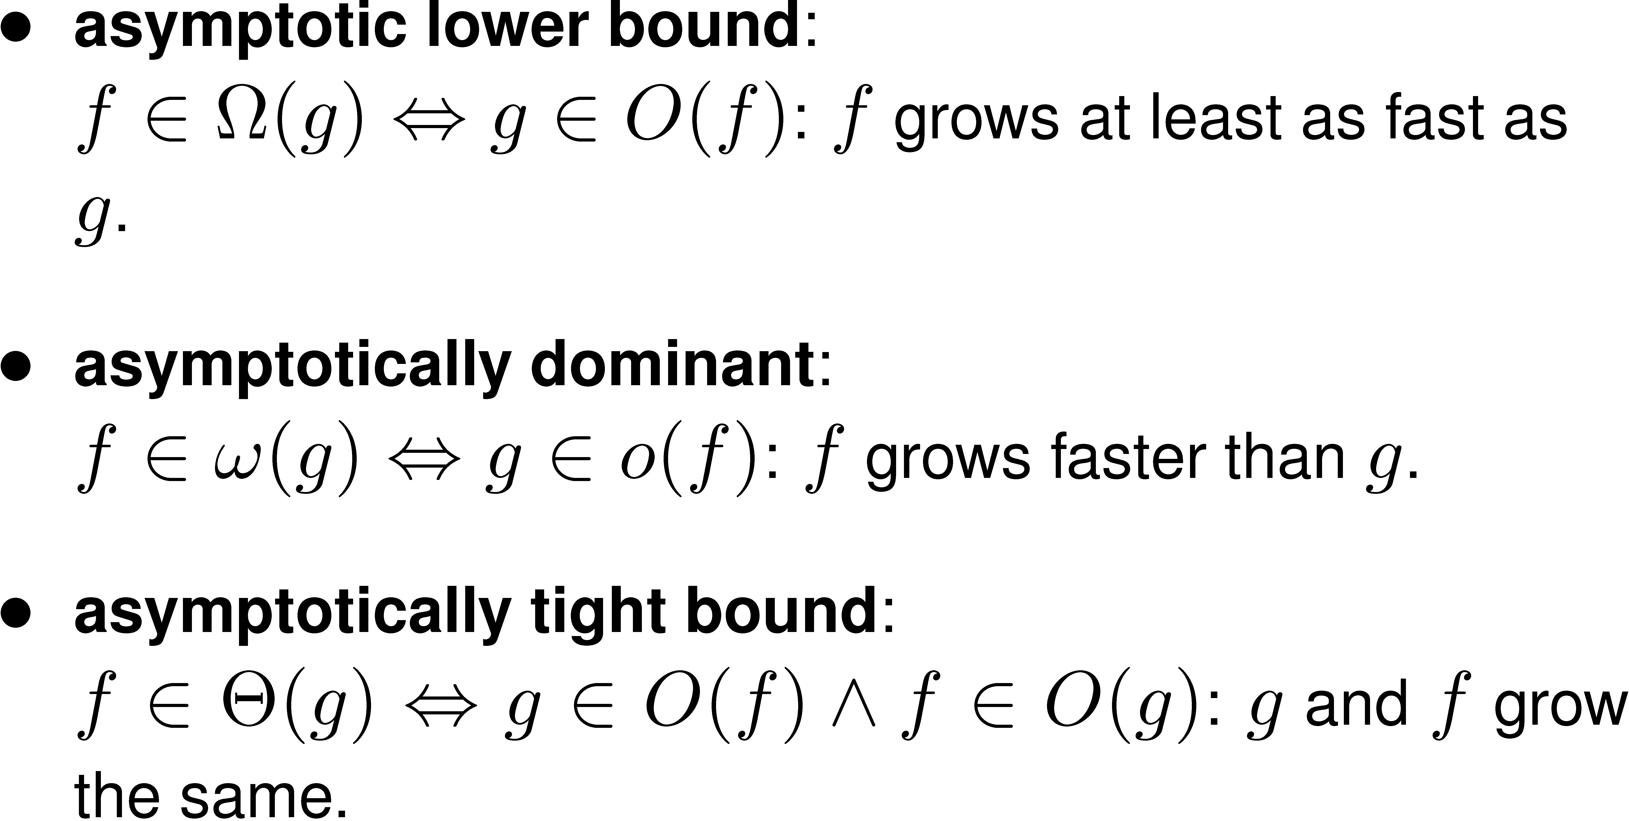
Landau notation
Optimization Problems – Problem Complexity
3. Problem Difficulty – Problem Complexity

Slide 63
Examples
Optimization Problems – Problem Complexity
3. Problem Difficulty – Problem Complexity
We want to find the smallest number in an unordered list of n numbers. The complexity of this problem is £(n) when using linear search and examining all possible elements in the list. As it is not possible to solve this problem faster than linear, there is no gap between the lower bound Ω(n) and upper bound O(n).
We want to find an element in an ordered list with O(n) items (for example finding a telephone number in the telephone book). Binary search iteratively splits the list in two halves and can find any item in log(n) search steps. Therefore, the upper bound on the complexity of this problem is O(log(n)). As the lower bound is equal to the upper bound (see literature), the complexity of the problem is £(log(n)).
We want to sort an array of n arbitrary elements. By using standard sorting algorithms like merge sort it can be solved in O(n log(n)). As the lower bound is Ω (n log(n)), the difficulty of this problem is £ (n log(n)).

Slide 64
Complexity Classes
Optimization Problems – Problem Complexity
3. Problem Difficulty – Problem Complexity
Computational complexity theory categorizes decision problems in different groups based on their difficulty.
Difficulty is defined with respect to the amount of computational resources that are at least necessary.
Effort (amount of computational resources) necessary to solve an optimization problem depends on time and space complexity.
  Time complexity: how many iterations/number of search steps are necessary to solve a problem.
  Space complexity: amount of space (memory) necessary to solve a problem.
Both depend on the size n of the problem.

Slide 65
Complexity Classes
Optimization Problems – Problem Complexity
3. Problem Difficulty – Problem Complexity
A set of problems where the amount of computational resources necessary to solve the problem have the same asymptotic behavior.
For all problems in one complexity class, we can give bounds on the computational complexity (in general, time and space complexity).
Usually, bounds depend on the size n of the problem.

Slide 66
Complexity Class P
Optimization Problems – Problem Complexity
3. Problem Difficulty – Problem Complexity
The complexity class P (polynomial) is the set of decision problems that can be solved by an algorithm with worst-case polynomial time complexity.
Time necessary to solve a problem in P is asymptotically bounded
(for n>n₀) by a polynomial function O(n^{k}).
For all problems in P, an algorithm exists that can solve any instance of the problem in O(n^{k}).
All problems in P can be solved effectively.

Slide 67
Complexity Class NP
Optimization Problems – Problem Complexity
3. Problem Difficulty – Problem Complexity
Set of decision problems where a “yes” solution of a problem can be verified in polynomial time.
  Formal representation of x and time to check its validity are polynomial or polynomially-bounded.
Set of all decision problems that can be solved by a non-deterministic algorithm in worst-case polynomial time
  A non-deterministic algorithm always selects the value (possibility) that leads to a “yes” answer, if a “yes” answer exists.
Both definitions of NP are equivalent to each other (Consider that non-deterministic algorithms can not be carried out by conventional computers and there is no idea how to construct a non-deterministic algorithm).

Slide 68
Complexity Class NP: Informally
Optimization Problems – Problem Complexity
3. Problem Difficulty – Problem Complexity
The class NP consists of all “reasonable” problems of practical importance where a “yes” solution can be verified in polynomial time
This means the objective value of the optimal solution can be calculated fast.
For problems not in NP, even verifying that a solution is valid (is a “yes” answer) can be extremely difficult (needs exponential time).
Optimization Problems: Difficulty

Slide 69
Tractable and Intractable Problems
Optimization Problems – Problem Complexity
3. Problem Difficulty – Problem Complexity
Problems that can be solved using a polynomial-time algorithm (upper bound O(n^{k}) on the running time of the algorithm, k constant) are tractable.
Tractable problems are easy to solve
Running time increases relatively slowly with larger problem size n.
Example: Finding the lowest element in an unordered list of size n is tractable. There are algorithms with O(n) time complexity. Spending twice as much effort allows us to solve problems twice as large.
Optimization Problems: Difficulty

Slide 70
Tractable and Intractable Problems
Optimization Problems – Problem Complexity
Problems are intractable if they cannot be solved by a polynomial-time algorithm and there is a lower bound on the running time which is Ω (k^{n}).
Example:
  Finding the correct number for a decimal door lock with n digits is intractable. The time necessary for finding the correct key is Ω(10^{n}). Using a lock with one more digit increases number of search steps by a factor of 10.
  We have n binary decision variables and assign a random variable to each solution. Resulting problem is closed under permutation. Finding optimal solution is £(log(n)).
Optimization Problems: Difficulty

Slide 71
Polynomial and Exponential functions
Optimization Problems – Problem Complexity
3. Problem Difficulty – Problem Complexity
constant | O(1)
logarithmic | O(log n)
linear | O(n)
quasilinear | O(n log n)
quadratic | O(n²)
polynomial (of order c) | O(n^{c}), c>1
exponential | O(k^{n})
factorial | O(n!)
super-exponential | O(n^{n})

Slide 72
NP-hard
Optimization Problems – Problem Complexity
3. Problem Difficulty – Problem Complexity
All decision problems in P are tractable
If we assume that P≠NP, then some problems are in NP but not in P.
They are difficult: no polynomial-time algorithms exist.
Among decision problems in NP, there are problems where no polynomial algorithm is available and which can be transformed to each other in polynomial time.
Consequently, a problem is denoted to be NP-hard if an algorithm for solving this problem is polynomial-time reducible to an algorithm that is able to solve any problem in NP.

Slide 73
NP-hard
Optimization Problems – Problem Complexity
A problem A is polynomial-time reducible to a different problem B if and only if there is a transformation that transforms any solution of A into a solution of B in polynomial time such that if and only if a solution is a “yes” instance for A it is also a “yes” instance for B.
Informally, a problem A is reducible to some other problem B if problem B has same difficulty or is easier than problem A.
Therefore, NP-hard problems are at least as hard as any other problem in NP, although they might be harder. Therefore, NP-hard problems are not necessarily in NP.

Slide 74
NP-complete
Optimization Problems – Problem Complexity
3. Problem Difficulty – Problem Complexity
Cook introduced the set of NP-complete problems as a subset of NP.
A decision problem A is denoted to be NP-complete if
  A is in NP and
  A is NP-hard.
No other problem in NP is more than a polynomial factor harder than any NP-complete problem.
NP-complete problems are the most difficult problems in NP.

Slide 75
NP-complete
Optimization Problems – Problem Complexity
All NP-complete problems form one set: NP-complete problems have the same complexity.
However, it is unclear if NP-complete problems are tractable, or not.
If we are able to find a polynomial-time algorithm for any one of the NP-complete problems, then every NP-complete problem can be solved in polynomial time.
Then, also all other problems in NP can be solved in polynomial time (are tractable) and thus P=NP.
On the other hand, if it can be shown that one NP-complete problem is intractable, then all NP-complete problems are intractable and P≠ NP (one million Dollar question!).

Slide 76
Different classes of NP optimization problems
Optimization Problems – Problem Complexity

Slide 77
No-Free-Lunch Theorem and Black-box optimization
Optimization Problems - NFL
There is a trade-off between effectiveness and application range of optimization methods
Black-box optimization methods are algorithms that need no additional information about the structure of a problem but are able to reliably and efficiently return high-quality solutions for a large variety of different optimization problems
NFL theorem says that Black-box optimization is not possible
An algorithm's performance can only be high if (correct) problem-specific assumptions are made about the structure of the optimization problem and the algorithm is able to exploit these problem-specific properties.

Slide 78
No-Free-Lunch Theorem
Optimization Problems - NFL
… for both static and time dependent optimization problems, the average performance of any pair of algorithms across all possible problems is exactly identical. This means in particular that if some algorithm A₁'s performance is superior to that of another algorithm A₂ over some set of optimization problems, then the reverse must be true over the set of all other optimization problems (Wolpert and Macready, 1997)

Slide 79
No-Free-Lunch Theorem
2. Grundlagen
Optimization Problems - NFL
Optimization Problem f; X → Y
  X is finite
  Y is finite and ordered
Heuristics search method H
Sequence of solutions generated by H:
H( f, m ) = ((x₁, f(x₁)), (x₂, f(x₂)), …, (x_{m}, f(x_{m})))
H generates x_{m+1} dependent on H( f, m )
  „Black-Box Algorithm“, solutions are only sampled once
We observe a sequence of fitness values H^{Y}( f, m ) = (f(x₁), f(x₂), …, f(x_{m}))
We measure performance of search g:
  g( H^{Y}( f, m ) )
  Example: g(f(x₁), f(x₂), …, f(x_{m})) = min_{i=1,…,m} {f(x_{i})}
Average performance (over all possible problems f)
  ∑_{f∈F} g( H^{Y}( f, m ) ) / |F|
Notes:
Notation leicht vereinfacht
Historie statt Trajektorie um Verwechslung mit Suchpfad (wo ein Zug i.d.R. nach vielen Beurteilungen kommt) lokaler Suchverfahren nicht aufzudrängen
Tm beinhaltet keine wiederholten Lösungen (über Dictionary machbar)
H ggf. probabilistisch
Alternatives Beispiel für Performanzmessfunktion: g = 1 g.d.w. Optimum ermittelt wurde, sonst 0

Slide 80
No-Free-Lunch Theorem
2. Grundlagen
Optimization Problems - NFL
Assumption: F is closed under permutation
  All possible permutations Π of the search space X
  Π : X → X,
  where f ^{Π} (x) = f ( Π⁻¹(x) )
  f ∈ F ⇒ f ^{Π} ∈ F
Example:
f
f ^{Π1}
f ^{Π2}
f ^{Π3}
f ^{Π4}
f ^{Π5}
Y
X
X
X
X
X
X
Notes:
Durchschnittlich heißt: alle f werden gleichgewichtet

Slide 81
No-Free-Lunch Theorem
Optimization Problems - NFL
The average performance of any pair of algorithms across all possible problems is exactly identical
(independent on how we measure the performance of the algorithms)
Notes:
Spezialfall der Voraussetzung ist die „Menge aller Funktionen X → Y“
Durchschnittlich heißt: alle f werden gleichgewichtet

Slide 82
Comments on NFL (1)
2. Grundlagen
Optimization Problems - NFL
Wolpert/Macready: „We cannot emphasize enough that no claims whatever are being made in this paper concerning how well various search algorithms work in practice.“
However, statements like „In general, metaheuristic H₁ is better than H₂ “ make no sense.
An algorithm's performance can be increased if (correct) problem-specific assumptions are made about the structure of the optimization problem and the algorithm is able to exploit these problem-specific properties.
Notes:
Vergleich verschiedener heuristischer Optimierungsverfahren später auch anhand experimenteller Ergebnisse veranschaulicht
Bestes Verfahren in Abhängigkeit von Problemgröße, Rechenzeit, … !!
→ es gibt in der Tat nicht „das beste“ Verfahren

Slide 83
Comments on NFL (2)
Optimization Problems - NFL
NFL holds for
Needle-in-a-haystack problems
Random problems with trivial topology, …
The NFL-Theorem does not hold for problems that are not closed under permutation
Decomposable problems
Problems with high locality
Problems, where neighboring solutions have similar fitness (Christensen and Oppacher, 2001)

Slide 84
Difficult of Problems for Heuristics
Optimization Problems - Locality
3. Problem Difficulty – Problem Complexity
Exact optimization methods (like Branch&Bound, cutting plane, and others) have exponential effort for NP-complete problems.
Heuristics are not optimal (no guarantee that optimal solution is found) but their effort can be adjusted by user. Solution quality is often good.
Question:
  What makes problems difficult (easy) for heuristics?
  For which problems do metaheuristics perform better than random search?

Slide 85
Number of local optima
Optimization Problems - Locality
One optimum: unimodal, can often be solved well by hillclimber
Even functions with low number of local optima can be arbitrarily hard. Compare needle in haystack with sphere, or deceptive traps
Number of optima no sufficient indicator for problem difficulty

Slide 86
Basins of attraction
Optimization Problems - Locality
For several optima: basin of attraction of local optimum is the set of solutions from which the local optimum is reached by a hillclimber („part of the same peak“)
Performance of local search correlates inversely with size of basin of attraction
Sphere function: one basin of attraction, usually simple to solve.

Slide 87
Measuring the locality of problems
Optimization Problems - Locality
3. Problem Difficulty - Locality
“Do similar solutions have similar fitness?”
Locality describes how well the distances d(x,y) between x,y 2 X correspond to the differences of the objective values |f(x)-f(y)|.
The locality of a problem is high
  if neighboring solutions have similar objective values
  and difference of the objective values increases with larger distance
The locality of a problem is low
  if small distances do not correspond to small differences of the objective values.

Slide 88
Measuring the locality of problems
Optimization Problems - Locality
The important determinants for the locality of a problem are
  the metrics defined on the search space
  and the objective function f
For continuous decision variables, locality is known as causality. High and low locality correspond to strong and weak causality, respectively.

Slide 89
Locality and guided search
Optimization Problems - Locality
3. Problem Difficulty - Locality
Guided search methods: iteratively sample solutions and use the objective values of previously sampled solutions to guide the future search process
In contrast to random search: distinguish between promising and non-promising areas in the fitness landscape
New solutions are usually generated in the neighborhood of promising solutions with high-objective values.
Most local search algorithms fall in this category

Slide 90
Locality and guided search
Optimization Problems - Locality
The locality of optimization problems has a strong impact on their difficulty for guided search methods.
High locality allows guided search to find high-quality solutions in the neighborhood of already found good solutions.
Moving from low-quality solutions to high-quality solutions works well if the problem has high locality.
If a problem has low locality, guided search can not make use of previous search steps
Can not extract information that can be used for guiding the search
For problems with low locality, guided search methods behave like random search.

Slide 91
Measures of Locality of Search Spaces
Optimization Problems - Locality
3. Problem Difficulty - Locality
Fitness-Distance Correlation
Ruggedness

Slide 92
Fitness-Distance Correlation (FDC)
Optimization Problems - Locality
3. Problem Difficulty - Locality
FDC measures the difficulty of problems for guided search methods
The difficulty of an optimization problem is determined by
  how the objective values are assigned to the solutions x2 X and
  what metric is defined on X.

Slide 93
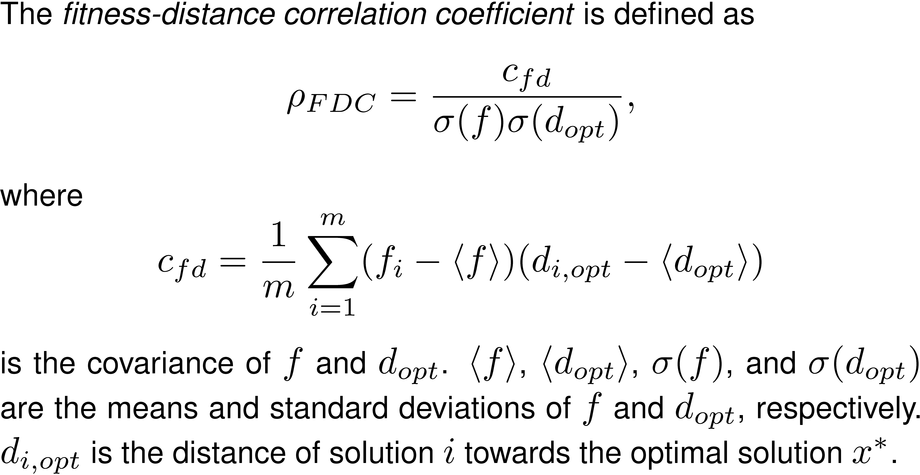
Fitness-Distance Correlation
Optimization Problems - Locality
3. Problem Difficulty - Locality

Slide 94
Fitness-Distance Correlation
Optimization Problems - Locality
3. Problem Difficulty - Locality
The fitness-distance correlation coefficient ½ _{FDC} 2 [-1,1] measures the linear correlation between the fitnesses of search points and their distances to the global optimum x*
As ½ _{FDC} represents a summary statistic of f and d_{opt} , it works well if f and d_{opt} follow a bivariate normal distribution.
For problems, where f and d_{opt} do not follow a normal distribution, using the correlation as a measurement of problem difficulty for guided search methods will not yield meaningful results.

Slide 95
Fitness-Distance Correlation
Optimization Problems - Locality
3. Problem Difficulty - Locality
Based on the FDC coefficient, we can classify fitness landscapes into three classes,
  straightforward (½ _{FDC} · -0.15)
  difficult (-0.15· ½ _{FDC} · 0.15)
  misleading (½ _{FDC} ¸ 0.15)
Straightforward:
  Fitness of a solution is correlated with the distance to the optimal solution.
  With lower distance, the fitness difference to the optimal solution decreases.
  The structure of the search space guides search methods towards the optimal solution
  Such problems are usually easy for guided search method.

Slide 96
Fitness-Distance Correlation
Optimization Problems - Locality
Difficult:
  No correlation between the fitness difference and the distance to the optimal solution.
  Fitness values of neighboring solutions are uncorrelated
  The structure of the search space provides no information about which solutions should be sampled next by the search method.
Misleading:
  Fitness difference is negatively correlated with distance to optimal solution
  Structure of the search space misleads a local search method to sub-optimal solutions.

Slide 97
Fitness-Distance Correlation
Optimization Problems - Locality
3. Problem Difficulty - Locality
Different classes of problem difficulty

Slide 98
Ruggedness
Optimization Problems - Locality
3. Problem Difficulty - Locality
For studying the FDC of problems, it is necessary to know the optimal solution.
However, in general the optimal solution is not known.
The difficulty of problems for guided search methods is influenced by properties of the fitness landscape like
  the number of local optima or peaks in the landscape,
  the distribution of the peaks in the search space, and
  the height of the different peaks.

Slide 99
Random walks and ruggedness
Optimization Problems - Locality
Correlation functions have been proposed to measure the ruggedness of a fitness landscape.
Like in fitness-distance correlation, the idea is to consider the objective values as random variables and to obtain statistical properties on how the distribution of the objective values depends on the distances between solutions.

Slide 100
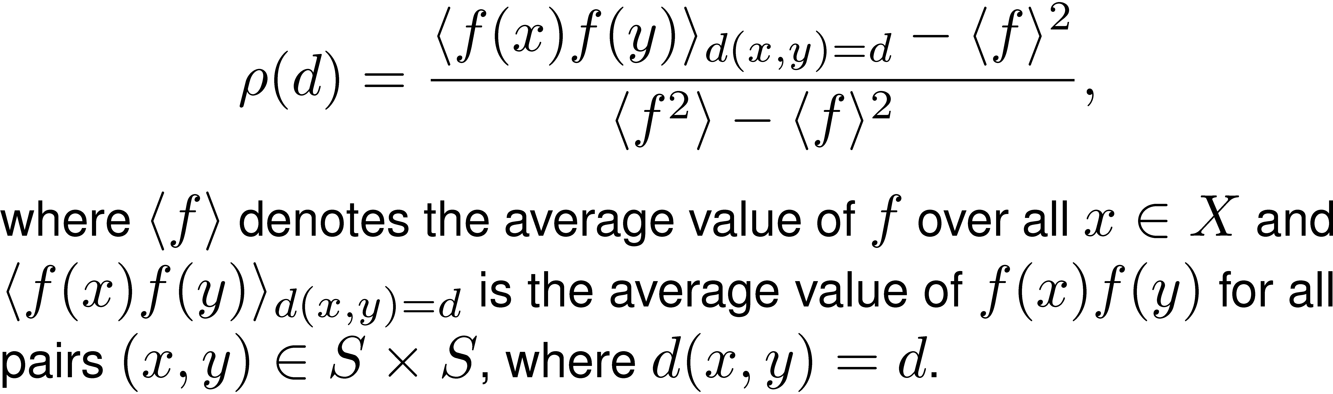
Ruggedness
Optimization Problems - Locality
3. Problem Difficulty - Locality
The autocorrelation function of a fitness landscape is defined as

Slide 101
Ruggedness
Optimization Problems - Locality
3. Problem Difficulty - Locality
The autocorrelation function has the attractive property of being in the range [-1,1]. An autocorrelation value of 1 indicates perfect correlation (positive correlation) and -1 indicates prefect anti-correlation (negative correlation).
For a fixed distance d, ½ is the correlation between the objective values of all solutions that have a distance of d.

Slide 102
Decomposability
Optimization Problems - Decomposability
3. Problem Difficulty - Decomposability
The decomposability of a problem describes how well a problem can be decomposed into several, smaller sub-problems that are independently of each other.
  The decomposability of a problem is high if the structure of the objective function is such that not all decision variable must be considered simultaneously to calculate the objective function but there are groups of decision variables that can be set independently of each other.
  It is low if it is not possible to decompose a problem into sub-problems that have little interdependencies between.

Slide 103
Decomposability
Optimization Problems - Decomposability
If a problem can only be solved by considering all n variables at the same time, it is not separable
If decisions about the next solution to visit can reliably be made with just considering k<<n decision variables, the problem is separable
Separable functions are often easier because less dimensions/variables depend on each other
Reduces number of solutions, e.g. 2^{k} << 2^{n}

Slide 104
Decomposability
Optimization Problems - Decomposability
3. Problem Difficulty - Decomposability
Decomposability is relevant for recombination-based search methods
Recombination-based methods try different decompositions of the problem, solve the sub-problems, put together the solutions for these sub-problems.
For such types of optimization methods, decomposability is meaningful as high decomposability results in low problem difficulty
Solving smaller sub-problems is usually easier than solving the larger, original problem.
Different approaches for measuring decomposability of problems:
  Polynomial decomposition
  Walsh Analysis
  Schemata Analysis and Building Blocks

Slide 105
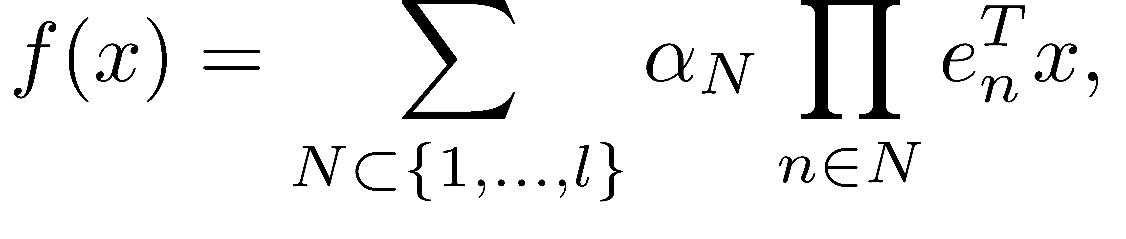
Polynomial Decomposition
Optimization Problems - Decomposability
3. Problem Difficulty - Decomposability
The linearity of an optimization problem can be measured by the polynomial decomposition of the problem.
It measures how well a problem can be decomposed into smaller sub-problem
For binary decision variables, each objective function f defined on l decision variables x_{i} 2 {0,1} can be decomposed in the form
where e_{n} contains 1 in n-th column and 0 elsewhere, T denotes transpose, the ®_{N} are coefficients

Slide 106
Polynomial Decomposition
Optimization Problems - Decomposability
The coefficients ®_{i} describe the non-linearity of the problem
If there are high order coefficients in the decomposition of the problem, the function is (highly) nonlinear.
If the decomposition of a problem only has order 1 coefficients, then the problem is linear decomposable.

Slide 107
Polynomial Decomposition
Optimization Problems - Decomposability
3. Problem Difficulty - Decomposability
It is possible to determine the maximum non-linearity of f(x) by its highest polynomial coefficients.
The higher the order of the ®_{i}, the more non-linear the problem is.
There is some correlation between the non-linearity of a problem and the difficulty of a problem for recombination-based search methods
The order of non-linearity can only give an upper limit on the problem difficulty.
There could be high order ®_{i} although the problem can still easily be solved by recombining search methods.

Slide 108
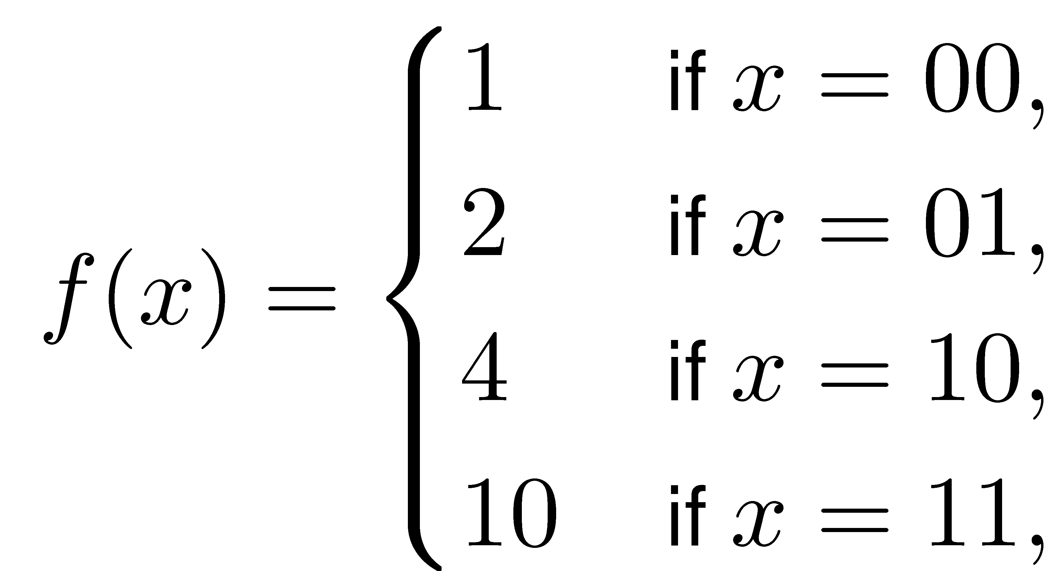
Polynomial Decomposition: Example
Optimization Problems - Decomposability
3. Problem Difficulty - Decomposability
f(x)=α₀+α₁x₀+α₂x₁+α₃x₀x₁=1+x₀+3x₁+5x₀x₁.
Easy for recombining search methods: two decision variables can be solved independently of each other.
The problem is (wrongly) classified as difficult.
This misclassification of problem difficulty is due to the fact that the polynomial decomposition assumes a linear decomposition and could not appropriately describe non-linear (quadratic) dependencies.

Slide 109
Schemata Analysis and Building Blocks
Optimization Problems - Decomposability
3. Problem Difficulty - Decomposability
Schemata analysis is mainly used in the genetic algorithm domain
Main search operator of genetic algorithms is recombination
Schemata are usually defined for binary search spaces and thus schemata analysis is mainly applicable to problems with binary decision variables. However, the ideas of building blocks are also applicable to other search spaces.
When using l binary decision variables x_{i}2{0,1}, a schema h=(h₁,h₂,…,h_{l}) is defined as a ternary string of length l
h_{i}2{0,1,*}. * denotes a“don't care” symbol and tells us that the lth decision variable is not fixed.

Slide 110
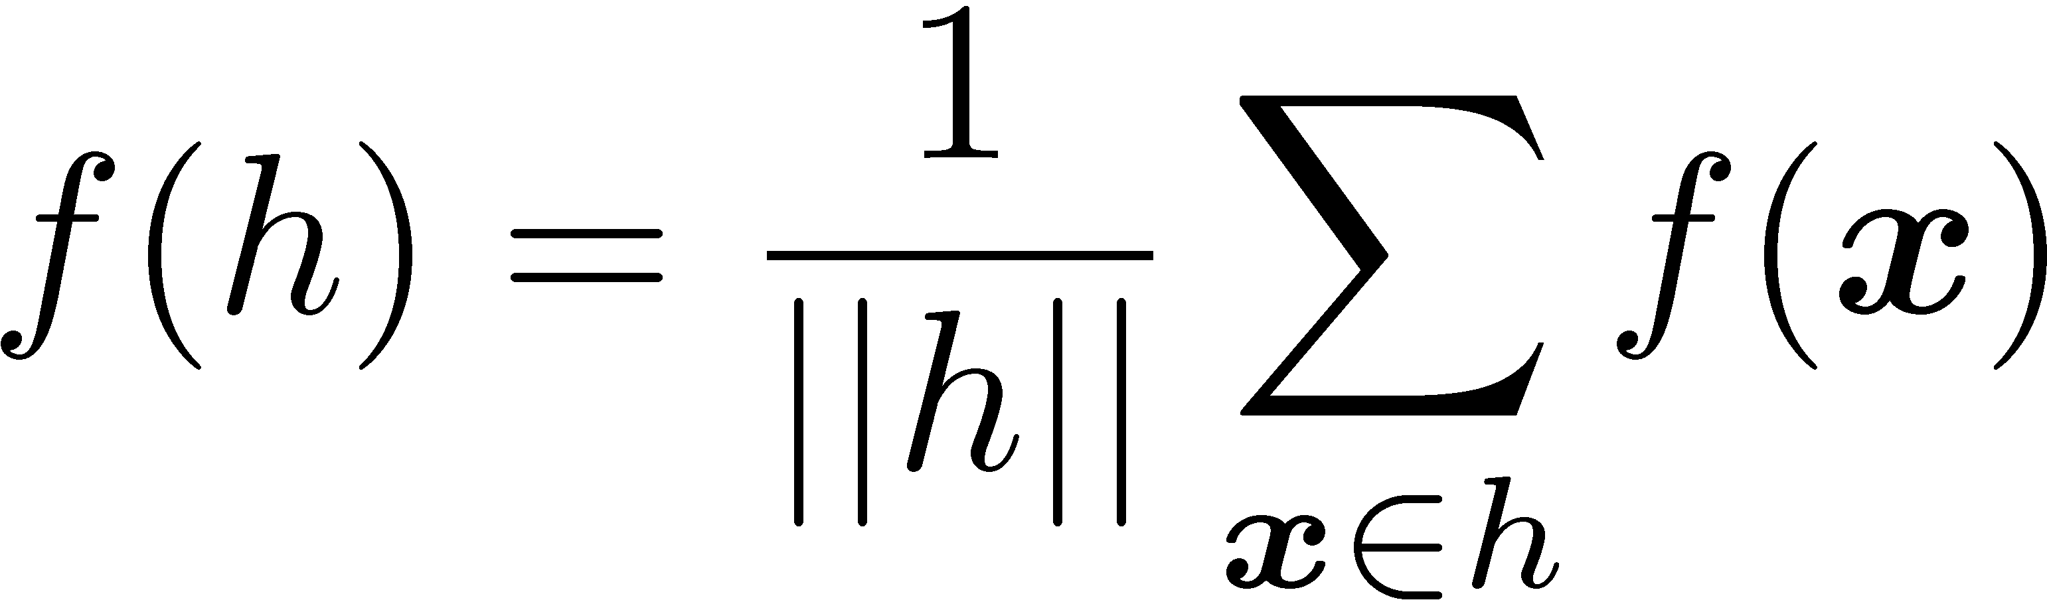
Schemata
Optimization Problems - Decomposability
3. Problem Difficulty - Decomposability
A position in a schema is fixed if there is a 0 or a 1
The size or order o(h) of a schema h is defined as the number of fixed positions (0s or 1s) in the schema string.
The defining length ±(h) of a schema h is defined as the distance between (number of bits that are between) the two outermost fixed bits.
The fitness f(h) of a schema is defined as the average fitness of all instances of this schema and can be calculated as
For example, x=01101 and y=01100 are instances of h=0*1**.
The number of solutions that are an instance of a schema h can be calculated as 2^{l-o(h)}.

Slide 111
Building Blocks
Optimization Problems - Decomposability
3. Problem Difficulty - Decomposability
“highly fit, short-defining-length schemata”.
A BB can be described as a solution to a subproblem that can be expressed as a schema. A thus-like schema has high fitness and its size is smaller than the length l of the binary solution.
By combining BBs of lower order, recombining search methods like genetic algorithms can form high-quality over-all solutions.
We can interpret BBs also from a biological perspective.
  Using the notion of genes we can interpret BBs as genes. A gene consists of one or more alleles and can be described as a schema with high fitness. The alleles in a chromosome can be separated (decomposed) into genes which do not interact with each other and which determine one specific property of an individual like hair or eye color.
BBs can be used to describe the difficulty of optimization problems for recombining search algorithms.
If the sub-solutions to a problem (the BBs) are short (low ±(h)) and of low order (low o(h)), then the problem is assumed to be easy.

Slide 112
BB-based Problem Difficulty
Optimization Problems - Decomposability
3. Problem Difficulty - Decomposability
There are three types of problem difficulty:
Difficulty within a building block (intra-BB difficulty)
Difficulty between building blocks (inter-BB difficulty)
Difficulty outside of building blocks (extra-BB difficulty)

Slide 113
Intra-BB difficulty
Optimization Problems - Decomposability
3. Problem Difficulty - Decomposability
If we count the number of schemata of order o(h)=k that have the same fixed positions, there are 2^{k} different schemata.
Viewing a BB of size k as a subproblem, there are 2^{k} different solutions to this subproblem.
Such subproblems can not be decomposed any more and usually guided or random search methods are applied to find the correct solution BB for the decomposed subproblems.
Deceptive Problems (see negative fitness distance correlation) are at the core of intra-BB difficulty
The intra-BB difficulty of a problem can be measured by the maximum length ±(h) and size k=o(h) of the BBs h.

Slide 114
Inter-BB and Extra-BB difficulty
Optimization Problems - Decomposability
3. Problem Difficulty - Decomposability
The contributions of different sub-problems to the objective function can be different. The sub-problems can have a non-uniform contribution to the overall objective value of a solution.
Important for inter-BB difficulty.
A problem can often not be decomposed into completely separated and independent sub-problems, but there are still some interdependencies between the different subproblems which are an additional source of inter-BB difficulty.
Sources of extra-BB difficulty are factors like noise.
Additional, non-deterministic noise can randomly modify the objective values of solutions and make the problem more difficulty for recombining search methods as no accurate decisions can be made on the optimal solutions for the different sub-problems.
A similar problem occurs if the evaluation of the solutions is non-stationary. Non-stationary environments results into solutions that have different evaluation values at different moments in time.

Slide 115
Representations
A Short Introduction to Representations
  Defining Representations
  Representations, Operators, and Metrics
  Direct and Indirect Representations
Design Guidelines for Representations
Properties of Representations
  High-Locality Representations
  Redundant Representations and Neutral Networks

Slide 116
Review: Modern heuristics
Modern heuristics
  Can be applied to a wide range of problems
  Use intensification (exploitation) and diversification (exploration) steps
Intensification steps shall improve quality
Diversification explores new areas of search space, also accepting complete or partial solutions that are inferior to current solution

Slide 117
Review: Principles of Modern Heuristics
Start with one or more random solutions
In iterative steps modify solution(s) to generate one or more new solution(s)
New solutions are created by search operators (variation operators)
Regularly perform intensification and exploration phases
  During intensification, use objective function value and focus variation on high-quality solutions
  During diversification, usually objective function values are not considered. Modify solutions so that new areas of search space are explored

Slide 118
Genotypes and phenotypes
Representations - Intro
Mendel recognized that nature stores information about an individual in pair-wise alleles
Genetic information determines properties, appearance, shape of an individual
Distinguish between genetic code and outward appearance
There is a transformation between the genetic information (genotypes) and the outward appearance (phenotypes)
Transformation is called a „representation“
Representations map genotypes on phenotypes

Slide 119
Defining representations (1)
Representations - Intro
A representation assigns genotypes to corresponding phenotypes.
Every search and optimization algorithms needs a representation.
The representation allows us to represent a solution to a specific problem.
Different representations can be used for the same problem.
Performance of search algorithm depends on properties of the used representation and how suitable is the representation in the context of the used genetic operators.

Slide 120
Defining representations (2)
Representations - Intro
An optimization problem f(x) can be separated into a genotype-phenotype mapping f_{g} and a phenotype-fitness mapping f_{p}
where f=f_{p}±f_{g} = f_{p}(f_{g}(x_{g}))
A change of f_{g} also changes the properties of f
The genetic operators mutation and crossover are applied to x_{g} whereas the selection process is based on the fitness of x_{p}
f_{p} (x_{p}) determines the fitness and complexity of the problem
f_{g} (x_{g}) determines the used representations

Slide 121
Standard genotypes: Binary genotypes
Representations - Intro
Commonly used in Genetic Algorithms
Recombination is main operator, mutation is background noise
Search space is ©_{g} = {0,1}^{l} where l is length of a binary vector x^{g} =(x^{g}₁ ,…, x^{g}_{l})
Representation depends on problem to be solved
Often natural for combinatorial problems
When using binary representations for integers, decide between unary, Gray, or binary.
When using binary representations for floats, precision depends on number of bits in genotype.

Slide 122
Standard genotypes: Integer genotypes
Representations - Intro
Use Â-ary alphabet instead of binary, where
{Â2N|Â >2} can also be used in phenotypes
Instead of coding 2^{l} solutions, size of search space
becomes Â^{l}
Recommended when phenotype is integer

Slide 123
Standard Genotypes: Continuous genotypes
Representations - Intro
The search space is ©_{g} = R^{l} where l is the size of the real-valued vector
Often used in evolution strategies, nonlinear numerical optimization, rely on local search
Can also encode permutations, trees, schedules, or tours.a

Slide 124
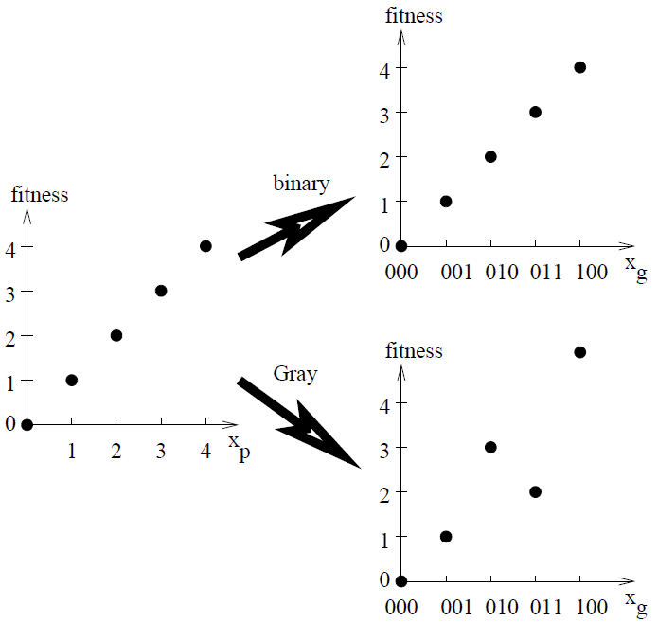
Representations make the difference
Representations - Intro
Representations change the character and difficulty of optimization problems
E.g. f_{p} = x_{p}, x2N
Different problem depending on the used representation

Slide 125
Representations make the difference (2)
Representations - Intro
Phenotypic problem easy to solve for hill-climber.
When using bit-flipping GA the Gray-encoded problem is easier to solve than the binary-encoded problem.
Gray encoding induces less local optima when used on problems of practical relevance (compare Free Lunch theorem).
Search performance depends on used search method. If other search methods (e.g. different operators) are used, then search performance is different

Slide 126
Representations, Operators, Metrics
Representations - Intro
Representation, metric defined on ©_{g} and ©_{p}, and genetic operators depend on each other and are closely related.
  A representation is just a mapping from ©_{g} to ©_{p} . It assigns any possible x_{g}2 ©_{g} to an x_{p}2 ©_{p}
  In both search spaces, ©_{g} and ©_{p}, a metric is or has to be defined. The metric determines the distances between the individuals and is the basis for measuring similarities between individuals. In general, the metric used for ©_{p} is defined by the considered problem. The metric used for ©_{g} is determined by the used search operators.
  Genotypic operators like mutation and crossover are defined based on the used metric

Slide 127
Representations, Operators, Metrics (2)
Representations - Intro
Mutation:
  The application of mutation to an individual results in a new individual with similar properties. There is a small distance between offspring and parent.
Crossover:
  Crossover combines the properties of two or more parents in an offspring. The distance between offspring and parent should be equal or smaller than the distance between both parents.

Slide 128
Representations, Operators, Metrics (3)
Representations - Intro
Results:
  Metric on ©_{g} and used operators depend on each other. The one determines the other.
  Representations “transform” the metric on ©_{g} to the (problem dependent) metric on ©_{p}. (Compare locality, causality, and distance distortion)

Slide 129
Direct representations
Representations - Intro
If the genetic operators are applied directly to the phenotypes it is not necessary to specify a representation and the phenotypes are identical with the genotypes:
This means, f_{g} is the identity function f_{g}(x_{g})=x_{g}. Using direct representations do not neccessarily make life easier:
  Design of proper operators is difficult
  How can we apply specific types or EAs (like EDAs)?
  Representation issues are not important any more (©_{g} = ©_{p} and f_{g}(x_{g})=x_{g}).

Slide 130
Direct representations – Genetic Programming
Representations - Intro
Representation issues are also relevant to Genetic Programming.
Phenotypes: Programs, logical expressions.
Genotypes: Parse trees, bitstrings, linear structures, ...
Neglecting proper genotype-phenotype mappings can result in low performance of GP approaches.
Example: Standard GP (expression tree representation and subtree swapping crossover) cannot solve problems where optimal solutions require very full or very narrow trees. This is due to problems of the representation (interplay between genotypes and used search operators).

Slide 131
Benefits of Indirect representations
Representations - Intro
The use of an explicite genotype-phenotype mapping has some benefits:
  specific constraints can be considered.
  Standardized genetic operators with known behavior and properties can be used.
  An indirect representation is necessary if problem-specific operators are either not available or difficult to design.
  Representation can make problem easier by incorporating problem-specific knowledge.

Slide 132
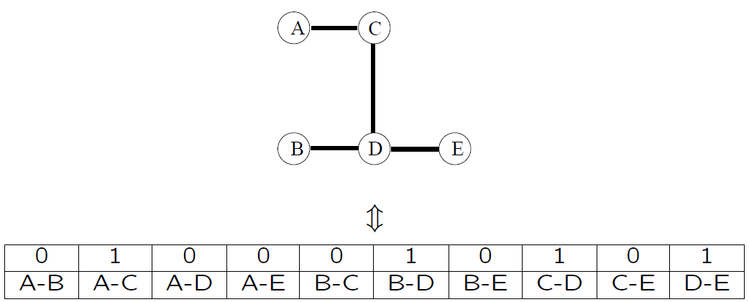
Specific constraints
Representations - Intro
Example: Tree optimization problems
A tree is a fully connected graph with exactly n−1 links (for an n node network). There are no circles in a tree.
A graph can be represented by its characteristic vector.

Slide 133
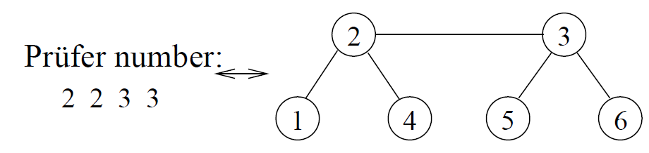
Specific constraints (2)
Representations - Intro
Prüfer numbers are a one-to-one mapping between trees and a sequence of integers (like other Cayley codes). A tree with n nodes is represented by a string of length n−2 over an alphabet of n symbols.
Therefore, using Prüfer numbers allows us to consider the constraint that the graph is a tree (For other representations repair operators are necessary).

Slide 134
Standardized operators
Representations - Intro
When mapping many different types of phenotypes on only a few types of different genotypes (binary, integer, or continuous representations), it is possible to use standardized operators.
Behavior of EAs for standard representations like binary (simple GAs) or continuous (evolution strategies) representations well understood.
Mapping phenotypes on binary genotypes allows the use of schemata and effective linkage learning GAs (under the assumption that the problem still remains decomposable and that binary encodings allow a natural encoding of the problem).

Slide 135
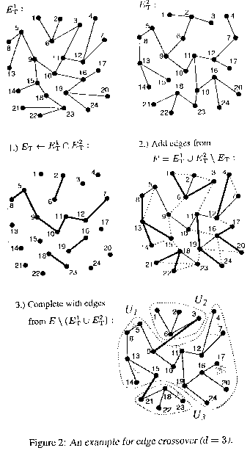
Problem-specific operators
Representations - Intro
Developing of problem-specific operators is difficult and often additional repair mechanisms must be used to ensure a valid solutiona

Slide 136
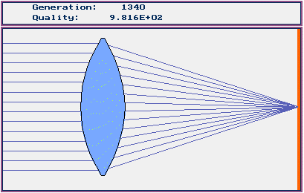
Problem-specific operators (2)
Representations - Intro
For some types of problems no problem-specific operators exist that can be applied to direct representations

Slide 137
Indirect Representations - Problem-specific Knowledge
Representations - Intro
Incorporating problem-specific knowledge in the representations to increase GA performance:
  Increase the initial supply of solutions that are similar to the optimal solution.
  Use high-locality representations for easy problems.
  Consider specific properties of the optimal solution (e.g. stars and trees).
  Use representations that make a problem easier for a specificoptimization method.

Slide 138
Goldberg’s Recommendations
Representations – Design Guidelines
Principle of meaningful building blocks: The schemata should be short, of low order, and relatively unrelated to schemata over other fixed positions.
Principle of minimal alphabets: The alphabet of the encoding should be as small as possible while still allowing a natural representation of solutions

Slide 139
Goldberg’s Recommendations (2)
Representations – Design Guidelines
The recommendations caused a lot of critics
  What is a natural representation of a problem? (For example, is using binary representations for encoding real-valued phenotypes a natural representation?)
Principles mainly aimed at binary representations and crossoverbased GAs that process schemata. No big help for other search methods like evolution strategies or evolutionary programming as these search methods do not process schema.

Slide 140
Radcliffe's recommendations
Representations – Design Guidelines
Representation and operators belong together and can not be separated from each other.
Design of representation-independent evolutionary algorithms is possible if the following properties are considered
  Respect: Offspring produced by recombination are members of all formae to which both their parents belong.
  Transmission: Every gene is set to an allele which is taken from one of the parents.
  Assortment: Offspring can be formed with any compatible characteristics taken from the parents.
  Ergodicity: Iterative use of operators allows the search method to reach any point in the search space.

Slide 141
Representation Invariant Genetic Operators
Representations – Design Guidelines
Fact: Performance of genetic algorithms using one-point crossover depends on order of objects (e.g. knapsack problem). Thus, one-point crossover is not invariant under changes in the order of objects.
Evolutionary operators are invariant with respect to a set of representations if EA performance is independent of used representation (how objects are encoded).
Rowe proposes an approach to generate invariant search operators.
Examples for appropriate (representation-independent) search operators for some types of problems (subset problems, permutation problems, and balanced partition problems).

Slide 142
Palmer’s Recommendations
Representations – Design Guidelines
An encoding should be able to represent all possible phenotypes.
An encoding should be unbiased in the sense that all possible individuals are equally represented in the set of all possible genotypic individuals.
An encoding should encode no infeasible solutions.
The decoding of the phenotype from the genotype should be easy.
An encoding should possess locality. Small changes in th genotype should result in small changes in the phenotyp (compare statements about metric).

Slide 143
Ronald‘s recommendations
Representations – Design Guidelines
Encodings should be adjusted to a set of genetic operators in a way that the building blocks are preserved from the parents to the offspring
Encodings should minimize nonlinearities in fitness functions. This means, representations should make the problem easier (for local search methods!).
Feasible solutions should be preferred.

Slide 144
Ronald‘s recommendations (2)
Representations – Design Guidelines
The problem should be represented at the correct level of Abstraction.
Encodings should exploit an appropriate genotype-phenotype mapping process if a simple mapping to the phenotype is not possible.
Isomorphic forms, where the phenotype of an individual is encoded with more than one genotype, should not be used.

Slide 145
Design Guidelines - Summary
Representations – Design Guidelines
Based on observations for specific test problems there are some common, fuzzy ideas about what is a good representation.
Some recommendations are too general to be helpful for designing or evaluating representations.
Analytical models describing the influence of representations on EAs are on their way.
To verify (or reject) observations analytical models are necessary.

Slide 146
Design Guidelines - Summary
Representations – Design Guidelines
Based on observations for specific test problems there are some common, fuzzy ideas about what is a good representation.
Some recommendations are too general to be helpful for designing or evaluating representations.
Analytical models describing the influence of representations on EAs are on their way.
To verify (or reject) observations analytical models are necessary.

Slide 147
Locality
Representations – High Locality Representations
Representations (genotype-phenotype mappings) can change the neighborhood and the structure of the fitness landscapes.
A neighbor can be reached directly by a move (mutation, crossover, etc). Therefore, the neighborhood depends on the used operator/metric.
The set of neighbors can be different for genotypes and phenotypes.
The distance between two individuals is determined by the number of moves between both individuals.

Slide 148
Locality of a Representation
Representations – High Locality Representations
The locality of a representation describes how well neighboring genotypes correspond to neighboring phenotypes.
Locality of a representation is high, if neighboring genotypes correspond to neighboring phenotypes.
Locality, causality, and distance distortion describe how well the metric on ©_{p} fits to the metric on ©_{g}. If they fit well, locality is high.
Representations f_{g} that change the distances between corresponding genotypes and phenotypes modify the performance of particular optimization problems (method performance(f) ≠ method performance(f_{p} )).

Slide 149
Different Phenotype-Fitness Mappings
Representations – High Locality Representations
Class 1: Fitness difference to optimal solution is positively correlated with the distance to optimal solution. Structure of the search space guides local search methods to the optimal solution → easy for mutation-based search.
Class 2: No correlation between fitness difference and distance to optimal solution. Structure of the search space provides no information for guided search methods → difficult for guided search methods.
Class 3: Fitness difference is negatively correlated to distance to optimal solution. Structure of search space misleads local search methods to sub-optimal solutions → deceptive problems

Slide 150
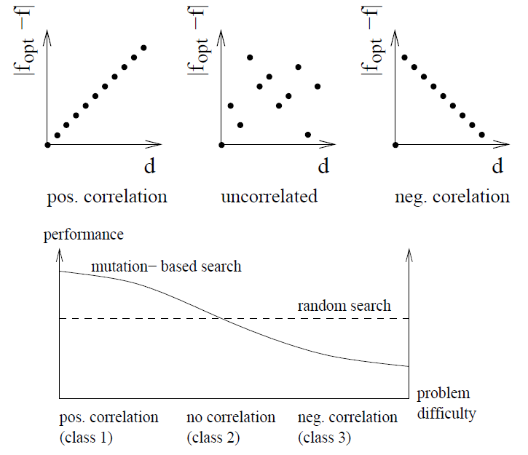
Different Phenotype-Fitness Mappings (2)
Representations – High Locality Representations

Slide 151
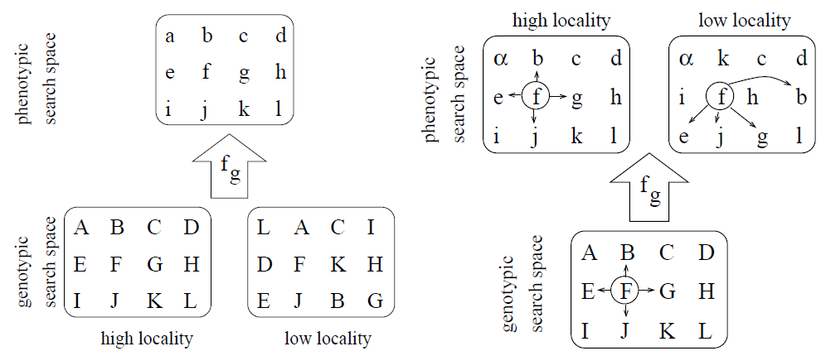
Low versus High-Locality Representations
Representations – High Locality Representations
Influence of high versus low-locality representations on genotype-
phenotype mappings
Effect of mutation for high
versus low-locality
representations

Slide 152
Low versus High-Locality Representations (2)
Representations – High Locality Representations
Class 1:
  High-locality representations preserve difficulty of problem. Easy problems remain easy for guided search.
  Low-locality representations make easy problems more difficult. Resulting problem becomes of class 2.
Class 2:
  High-locality representations preserve difficulty of problem. Problems remain difficult for guided search.
  Low-locality representations on average do not change class of problem. Problems remain difficult.
Class 3:
  High-locality representations preserve deceptiveness of problem. Traps remain traps.
  Low-locality representations transform problem to class 2 problem. Deceptive problems become more easy to solve for guided search.

Slide 153
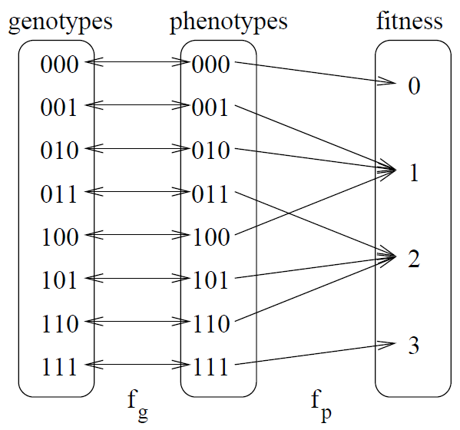
Example
Representations – High Locality Representations
Both, genotypes and phenotypes are binary.
We use the bit-flipping operator as a move (Hamming distance).
One-max problem (class 1).
All building blocks (regarding genotypes and phenotypes) are of size k=1. Therefore, problem is easy for selectorecombinative GAs

Slide 154
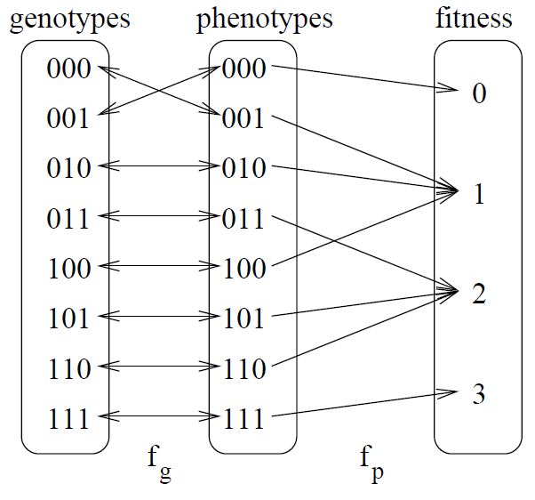
Example
Representations – High Locality Representations
A representation with lower locality.
The neighborhood structure changes.
Not all genotypic building blocks are of size 1. Although, f_{p} remains unchanged, f becomes more difficult for guided search.

Slide 155
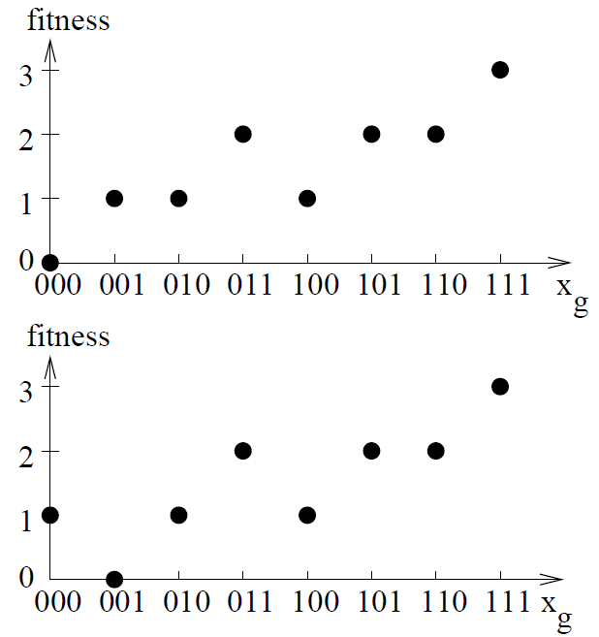
Example
Representations – High Locality Representations
High-locality representation.
Problem easy for Selectorecombinative GAs.
Different fitness for genotypes 000 and 001.
Problem more difficult for selectorecombinative GAs.
Neighborhood not preserved by representation.

Slide 156
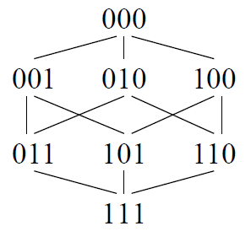
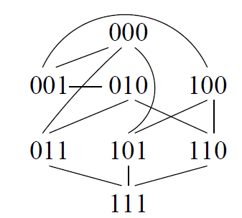
Example
Representations – High Locality Representations
Neighborhood structure of the genotypes
Resulting neighborhood structure of phenotypes

Slide 157
Comparing representations
Representations – High Locality Representations
We compare the performance of selectorecombinative Gas over all different representations for the one-max problem.
When focusing on binary bitstrings and assigning l-bit genotypes to l-bit phenotypes, there are 2^{l}! different representations.
For l=3 there are 8 different genotypes, resp. phenotypes, and 8! = 40, 320 different representations.
36 different representations result in the same overall problem f (for the one-max problem).

Slide 158
Comparing representations
Representations – High Locality Representations
To reduce problem complexity, x_{g} = 111 is always assigned to
x_{p}=111. Therefore, there are 7! = 5040 different representations.
We concatenate ten 3-bit problems and use a GA with tournament selection of size 2, uniform crossover, and N=16.

Slide 159
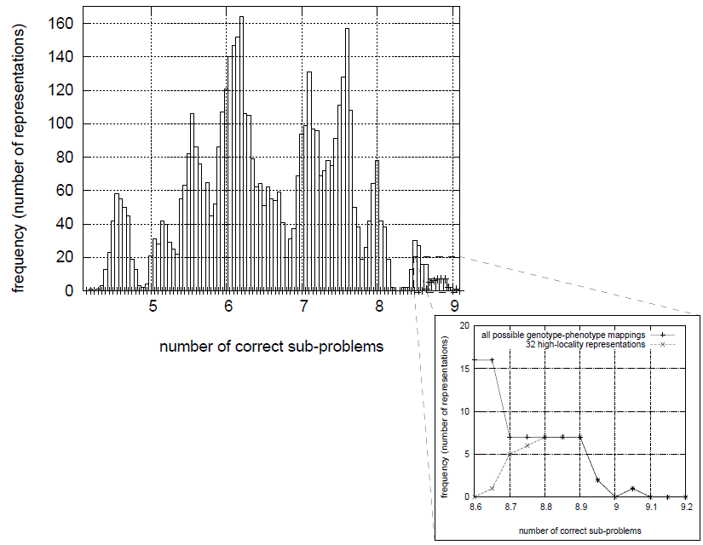
Comparing representations
Representations – High Locality Representations

Slide 160
Summary
Representations – High Locality Representations
When using high locality representations, genotypic neighbors correspond to phenotypic neighbors.
High locality representations do not change the structure and difficulty of the problem.
  Easy problems remain easy.
  Difficult problems remain difficult.
  Locality depends on the used distance metrics which depend on the used operators.

Slide 161
Redundant representations
Representations – Redundant Representations
Representations are redundant if the number of genotypes is larger than the number of phenotypes.
  Using redundant representations f_{g} means changing f = f_{p} (f_{g} ). There are additional plateaus in the fitness landscape.
  Redundant representations are more “inefficient” encodings which use a higher number of alleles but do not increase the amount of encoded information.
  Redundant representations are not an invention of AI researchers but are commonly used in nature.

Slide 162
Redundant representations (2)
Representations – Redundant Representations
There are different opinions regarding the influence of redundant representation on the performance of EAs.
Redundant representations reduce EA performance due to loss of diversity (Davis, 1989; Eshelman and Schaffer, 1991; Ronald et al., 1995)
Redundant representations increase EA performance (Gerrits and Hogeweg, 1991; Cohoon et al., 1988; Julstrom, 1999)

Slide 163
Redundant representations (3)
Representations – Redundant Representations
Large amount of work considers the neutral theory (Kimura, 1983). This theory assumes that not natural selection fixing advantageous mutations but the random fixation of neutral mutations is the driving force of molecular evolution.
Following these ideas redundant representations (neutral networks) have been used in EAs with great enthusiasm.
There was hope that increasing the evolvability of a system also increases the performance of the system
This is not true!

Slide 164
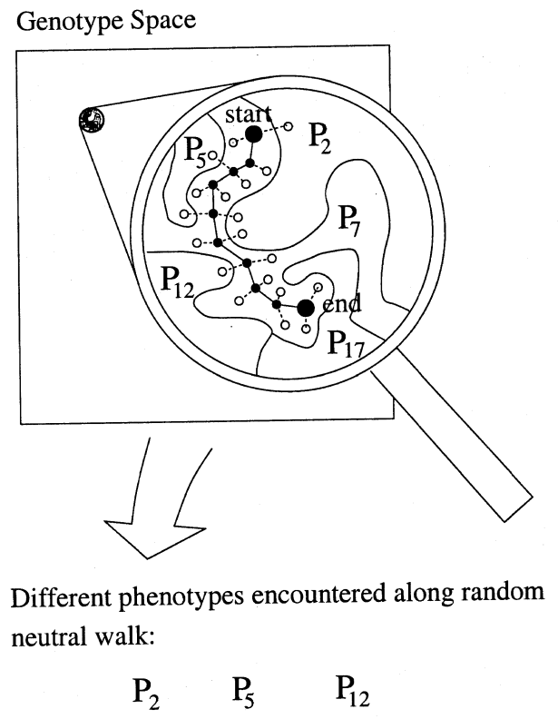
Redundant representations (4)
Representations – Redundant Representations
Neutral Network: Set of genotypes connected by single-point mutations that map to the same phenotype

Slide 165
Guide
Representations – Redundant Representations
In the following slides we study
  how to distinguish between synonymously and non-synonymously redundant encodings
  how synonymous redundancy changes performance of Eas (quantitative predictions), and
  the properties of non-synonymously redundant representations

Slide 166
Redundant representations (5)
Representations – Redundant Representations
Benefits of Neutral Networks
  Population can drift along these neutral networks.
  Reducing the chance of being trapped in sub-optimal solutions.
  Population is quickly able to recover after a change has occurred.
  Evolvability and connectivity of the system increases.
Problems
  Higher evolvability and connectivity → Randomization of search
  Genetic drift?

Slide 167
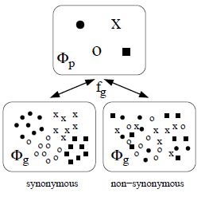
Synonymously versus non-synonymously redundant representations
Representations – Redundant Representations
When using redundant representations it can be distinguished between:
  Synonymously redundant representations: All genotypes that encode the same phenotype are similar to each other.
  Non-synonymously redundant representations: Genotypes that encode the same phenotype are not similar to each other.

Slide 168
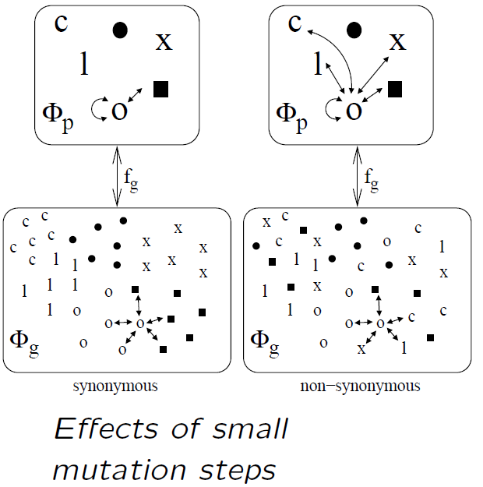
Synonymously versus non-synonymously redundant representations
Representations – Redundant Representations
Non-synonymously redundant representations do not allow guided search.
  EA search becomes random.
  Similar effect as low locality representations.

Slide 169
Synonymously versus non-synonymously redundant representations
Representations – Redundant Representations
(Choi and Moon, 2003) defined uniformly redundant encodings that are maximally non-synonymous and proved that such encodings induce uncorrelated search spaces (fitness distance correlation is equal to zero).
For a maximally non-synonymous redundant encoding, the expected distance between any two genotypes that correspond to the same phenotype is invariant and about equal to the problem size n.
Normalization (transformation of one parent to be consistent with the other) can transform uncorrelated search spaces into correlated search spaces with higher locality.

Slide 170
Synonymously versus non-synonymously redundant representations
Representations – Redundant Representations
Some selected examples for problems with maximally non-synonymous redundant encodings :
  Partitioning problems in graphs: k subsets are represented by integers from 0 to k−1 where nodes are contained in the same group if they are represented by the same number.
  Each phenotype is represented by k! different genotypes. HIFF problems (Watson et al., 1998): binary encoding where each phenotype is represented by a pair of bitwise complementary genotypes.
  TSP: Order-based crossover, in which vertices are indexed from 1 to n and each tour is represented by a permutation of the vertex indices. Each phenotype is represented by 2n genotypes

Slide 171
Modeling redundant representations
Representations – Redundant Representations
Synonymously redundant representations can be described using
  order of redundancy
  over-, resp. underrepresentation r of the optimal solution due to the problem representation f_{g}.
When using the notion of BBs and binary representations:
  r: Number of genotypic BBs of order k_{g} that represent the optimal phenotypic BB of order k_{p}.

Slide 172
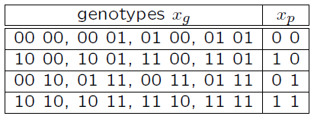
Modeling redundant representations
Representations – Redundant Representations
k=2 (order of phenotypic BBs)
k_{r}=2 (One allele of a phenotype is represented using two alleles of a genotype)
Uniform redundancy: r=4 (the best BB (e.g.. x_{p} = 11) is represented by four genotypic BBs)

Slide 173
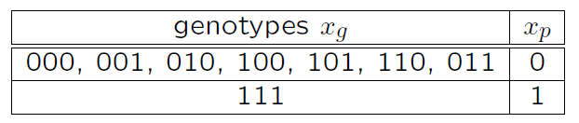
Modeling redundant representations
Representations – Redundant Representations
k=1 (order of phenotypic BBs)
k_{r}=3 (One phenotypic allele is represented using three genotypic alleles)
Non-uniform redundancy: r=1 (best BB (x_{p} = 1) is represented by one genotypic BB (x_{g} = 111))

Slide 174
Population sizing for GAs
Representations – Redundant Representations
The Gambler’s ruin model (Feller, 1957) can be used for modeling the iterated decision making in GAs.
A gambler with initial stake x₀ wishes to increase his funds to a total of N units by making a sequence of bets against a gaming house. Each bet has fixed probability p of winning (q =1−p of losing), and we wish to know the probability of succeeding (getting N units) or failing (losing all units).
Following (Harik et al., 1997) the probability that a GA with a population size N converges after tconv generations to the correct solution is

Slide 175
Population sizing for GAs (2)
Representations – Redundant Representations
After some calculations we get:
N is the necessary population size, ® = 1 − P_{n} the probability P_{n} that the optimal BB cannot be found (probability of failure) and k is the order of the BBs.
¾_{BB} (variance of BBs), d (fitness difference between best and second best BB), m′ = m−1 (number of BBs) and k are problem-dependent.

Slide 176
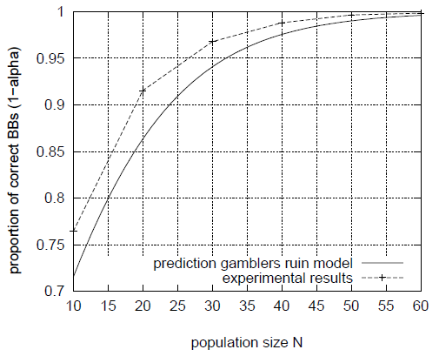
Population sizing for GAs (3)
Representations – Redundant Representations
150-bit one-max problem
(k=1, ¾_{BB}=0.25, d=1 and m=150)

Slide 177
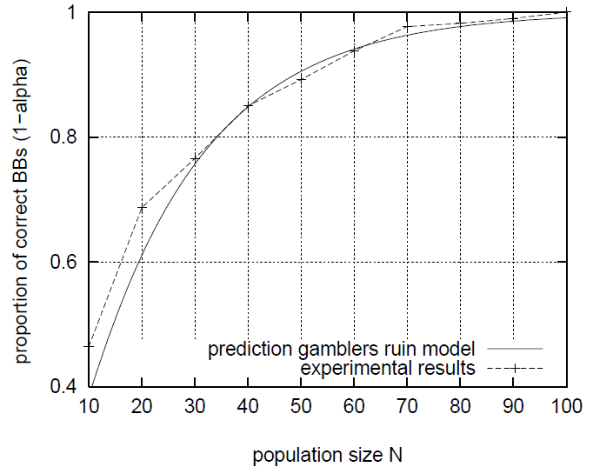
Population sizing for GAs (4)
Representations – Redundant Representations
Ten concatenated 3-bit deceptive traps
(k=3, ¾_{BB} = 1, d=1 and m=10)

Slide 178
Population sizing for GAs (5)
Representations – Redundant Representations
Now we have to ask how the redundancy of a representation influences GA performance?
Observation: Redundant representation change the initial supply x₀ of BBs.
For binary problem representation:
where N is the population size.

Slide 179
Population sizing for GAs (6)
Representations – Redundant Representations
When using synonymously redundant representations the existing model can be extended:
The population size N that is necessary to find the optimal solution with probability P_{n}=1−®
goes with

Slide 180
Population sizing for GAs (7)
Representations – Redundant Representations
Conclusions from this model:
  Redundant representations can change the performance of EAs.
  If representations are synonymously redundant:
    Uniformly redundant representations do not change the performance of EAs!
    If the optimal BB is overrepresented GA performance increases.
    If the optimal BB is underrepresented GA performance decreases.
Redundant representations can not be used systematically if there is no problem-specific knowledge!

Slide 181
Example: Trivial voting mapping
Representations – Redundant Representations
The trivial voting mapping (TVM) assigns binary phenotypes to binary genotypes.
One bit of the phenotype is represented by k_{r} genotypic bits.
In general, a phenotypic bit is 0 if less than u genotypic bits are zero. If more than u genotypic bits are 1 then the phenotypic bit is 1.
For u=k_{r}/2 the value of the phenotypic bit is determined by the majority of the genotypic bits (majority vote)
In general:
where u2 {1,…,k_{r}}.

Slide 182
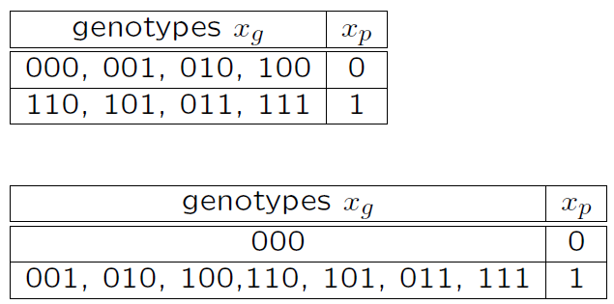
Examples
Representations – Redundant Representations
k=1
k_{r}=3
u=2
k=1
k_{r} =3
u=1

Slide 183
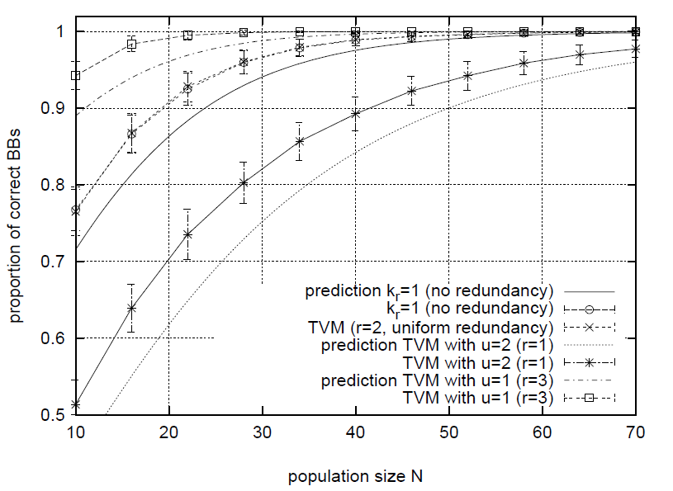
Trivial voting mapping (3)
Representations – Redundant Representations
Experimental and theoretical results of the proportion of correct BBs on a 150-bit one-max problem using the trivial voting mapping for k_{r}=2.

Slide 184
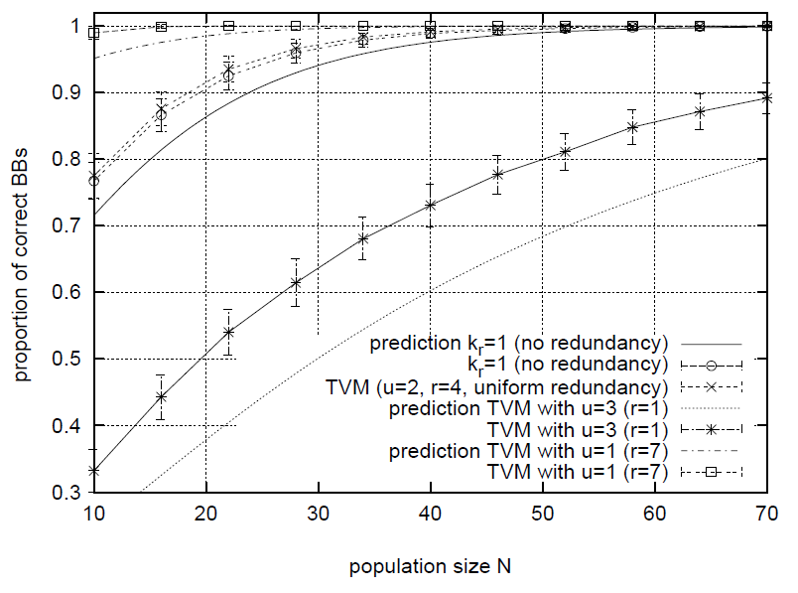
Trivial voting mapping (4)
Representations – Redundant Representations
Experimental and theoretical results of the proportion of correct BBs on a 150-bit one-max problem using the trivial voting mapping for k_{r}=3.

Slide 185
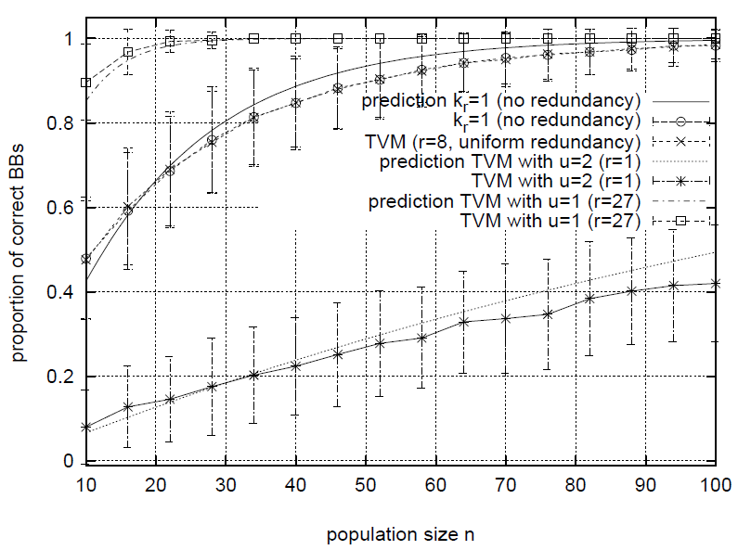
Trivial voting mapping (5)
Representations – Redundant Representations
Experimental and theoretical results of the proportion of correct BBs for ten concatenated 3-bit deceptive traps and k_{r} = 2.

Slide 186
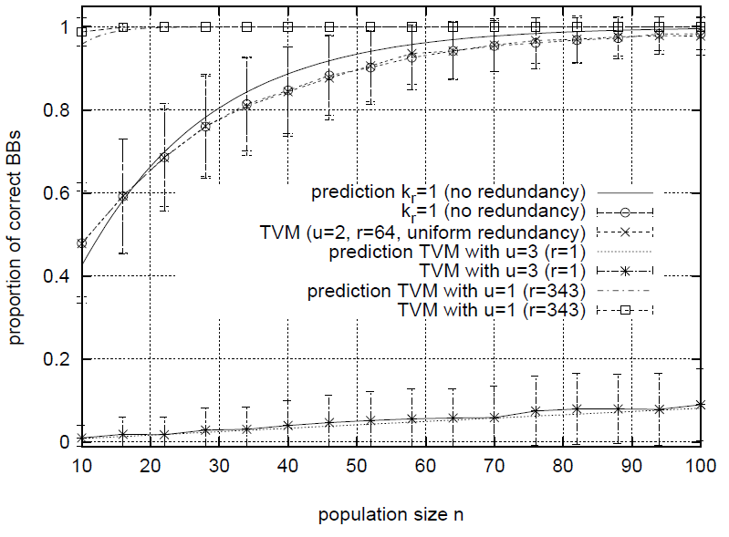
Trivial voting mapping (6)
Representations – Redundant Representations
Experimental and theoretical results of the proportion of correct BBs for ten concatenated 3-bit deceptive traps and k_{r} = 3.

Slide 187
Population sizing for GAs (8)
Representations – Redundant Representations
What must be considered when using redundant representations?
  How does the used representation change the size of the search space?
  Is the representation synonymously redundant?
  Are some solutions overrepresented?
Examining these properties allows the user to increase the performance of EAs!

Slide 188
Summary
Representations – Redundant Representations
There are theoretical models that allow us to predict the expected GA performance when using redundant representations (N = O(2^{kr} /r)).
There are guidelines for the design of redundant representations:
  Do not use non-synonymously redundant representations!
  If you use redundant representations you have to investigate:
    How does the representation change the size of the search space?
    Are solutions similar to the optimal solution overrepresented?
If there is no knowledge about the optimal solution use a uniformly redundant representation.

Slide 189
Search Operators
Design Principles
  Local Search Operators
  Recombination Operators
Standard Search Operators

Slide 190
Recap: Design of Search Operators
Search Operators – Design Principles Local Search Operator
Mutation:
  The application of mutation to an individual results in a new individual with similar properties. There is a small distance between offspring and parent.
Crossover:
  Crossover combines the properties of two or more parents in an offspring. The distance between offspring and parent should be smaller than the distance between both parents.

Slide 191
Local search operators
Search Operators – Design Principles Local Search Operator
Goal: find fitter individual by performing neighborhood search
Local search creates offspring that are similar to parents
Metric and operator thus depend on each other
A metric defines possible local search operators and a local search operator determines the metric
Assumptions:
  structure of metric/fitness landscape has to guide search towards optimal solution
  Good solutions can be found by a series of small steps
  Good solutions are typically clustered, so that they can be found in the neighborhoods of other good solutions

Slide 192
Local search for binary genotypes
Search Operators – Design Principles Local Search Operator
Distance between two solutions often measured by Hamming distance d(x,y)
Local search usually generates solutions with d=1
„Standard mutation“ or „bit flipping“
l-bit string has l neighbors

Slide 193
Local search for integer genotypes
Search Operators – Design Principles Local Search Operator
For different metrics, different operators are necessary
Binary Hamming metric
  Two solutions are neighbors if they differ in one decision variable.
  Operator based on this metric can randomly change one decision variable.
  Solution x2 {0,…,k}^{l} has lk neighbors.
  Example: x=(0,0) with x_{i} = {0,1,2} has four neighboring solutions ((1,0),(2,0),(0,1),(0,2)).
City-block metric:
  Local search can slightly decrease or increase one of the decision variables (adding +/-1).
  Each solution of length l has at most 2l neighbors. Example: x=(0,0), x_{i}2 {0,1,2} has 2 neighbors ((1,0),(0,1))

Slide 194
Local search for integer genotypes
Search Operators – Design Principles Local Search Operator
Different when operator exchanges values of two decision variables x_{i}, x_{j}
Using Hamming distance, two neighbors have distance d=2, each solution has at most different neighbors
x=(3,5,2) has 3 neighbors ((5,3,2),(2,5,3),(3,2,5))

Slide 195
Local search for continuous genotypes
Search Operators – Design Principles Local Search Operator
Analogue to integer genotypes
Hamming distance: assign random variable
x_{i}2 [x_{min} , x_{max}] to i-th decision variable
We can also define exchange operator
Using city-block metric is a bit more complex
  Search step should not be too small (we want progress)
  … and not too large (offspring should be similar to parent)
  Add random variable with zero mean: usually Gaussian with ¹=0, and standard deviation ¾ controlling „step-size“

Slide 196
Recombination operators
Search Operators – Design Principles Recombination Operator
Requires a population of solutions
Goal is to combine meaningful properties from >1 parents
Like local search, recombination-based search is based on a metric
Given two parents x^{p1} , x^{p2} and one offspring xº, recombination should be designed such that
  max(d(x^{p1} , xº), d(x^{p2} , xº)) · d(x^{p1}, x^{p2}))
Offspring should be „between the parents“
Why use recombination?
  Real-world problems are often decomposable
  Large problems can be solved by decomposing it into smaller sub-problems (that are usually easier to solve) and combined to form overall solution

Slide 197
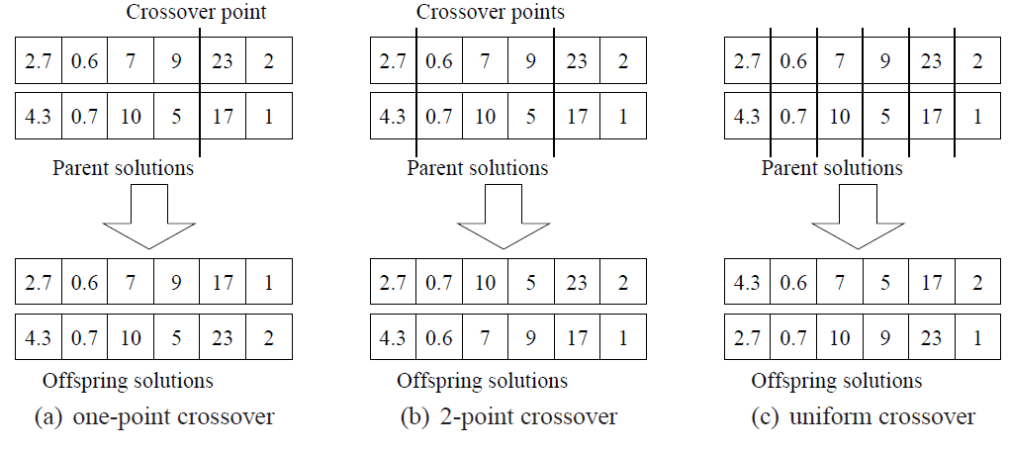
Common recombination operators
Search Operators – Design Principles Recombination Operator

Slide 198
Intermediate recombination
Search Operators – Design Principles Recombination Operator
Uniform and n-point crossover can be applied independent of type of decision variable (binary, discrete, continuous…)
In contrast, intermediate recombination operators try to blend/average over several parents. We explain arithmetic crossover.
For two parents x^{p1}, x^{p2}, offspring is
For m parents,
Takes weighted average of parents‘ decision variables

Slide 199
Standard search operators
Search Operators – Standard Operator
We provide an overview of operators for standard search spaces
Can be genotypes or phenotypes (direct representation)
Ordered by increasing complexity

Slide 200
Strings and Vectors
Search Operators – Standard Operator
Ordered lists of decision variables of fixed or variable length
Often used
Appropriate for sequences of characters or patterns. objects are modeled as
  text,
  characters,
  patterns.
Can use standard local search and recombination-based operators based on (binary) Hamming metric
If length is variable, Levenshtein distance can be used

Slide 201
Coordinates and Points
Search Operators – Standard Operator
Represent locations in geometric space
Integer or continuous
Often: locations of cities or other spots on a 2d-grid
Appropriate for problems that work on
  sites,
  Positions, or
  locations.
Standard local and recombination operators for continuous decision variables or integers
Euclidean metric

Slide 202
Graphs
Search Operators – Standard Operator
Represent relationships between arbitrary objects
Structure can be described as list of edges (with n nodes, there are n(n-1)/2 possible edges)
Appropriate for problems that seek a
  network,
  graph, or
  relationship
Common genotype is binary list of length n(n-1)/2
Standard operators are based on Hamming metric: number of different edges
If no additional constraints: standard search operators are applicable

Slide 203
Subsets
Search Operators – Standard Operator
Selections from a set of object; order of elements in set does not matter
Given n objects, there are subsets of size k and 2^{n} different subsets.
Subset of fixed size k can be represented by an integer vector x of length k, where the x_{i} indicate the selected objects and x_{i}≠ x_{j} for i≠ j and i,j2 [1,k]
Appropriate for problems that seek a
  cluster, collection, partition, group, packaging, or selection.
Can use standard local search if each selected object is unique
Recombination operators are difficult (Falkenauer , 1998; Choi and Moon, 2003)
  Each subset is represented by k! different genotypes
  Redundancy

Slide 204
Permutations
Search Operators – Standard Operator
Orderings of items,
n! permutations of n objects
Many permutation problems are relevant but NP-hard
Used in problems that seek an
  arrangement, tour, ordering, or sequence.
Design of operators is demanding
Often, an integer genotype of length n is used, where x_{i} denotes an object and has a unique value
Standard operators fail: offspring usually is no permutation

Slide 205
Permutations
Search Operators – Standard Operator
Permutation-specific operators are based on absolute or relative ordering.
  Absolute ordering: Two solutions are similar, if objects have same absolute position
  Relative ordering: Two solutions are similar, if relative order of pairs is similar
Order crossover, partially matched crossover, … there are many operators specifically designed for permutation problems.
See Whitley (1997), Mattfeld (1996), or Choi and Moon (2008)

Slide 206
Fitness Function
Design Guidelines
Examples

Slide 207
Fitness function and objective function
Fitness Function – Design Guidelines
Fitness function is quality of solution as „seen by the heuristic“
Objective function (evaluation function) is based on problem model
In general, fitness function and objective function are the same, but we can modify fitness function to make search easier for a modern heuristic
Then, we would not use original objective function from model, but a variant thereof

Slide 208
Ordinal and numerical ranking
Fitness Function – Design Guidelines
Fitness and objective functions can be ordinal or numerical
Ordinal functions order solutions in a sequence
  Allow us to compare quality (best, second-best, …, worst)
  No absolute value of quality available
  Often used when fitness is evaluated by human experts who rank alternatives
Numerical objective functions assign a real-valued objective value to all solutions
  Ordering possible
  Absolute value is available
  Standard for most mathematical models of cost, profit, lengths…

Slide 209
Design of objective function
Fitness Function – Design Guidelines
Make sure:
  Best solution should have highest quality
  Should make problem straightforward for local search
  Should make problem decomposable for recombining methods
In general, dissimilarity (measured by problem metric) should be positively correlated with difference in objective values

Slide 210
Example 1: Needle in haystack
Fitness Function - Examples
Search space X of size n
Objective function assigns highest value to best solution (f(max_{x} x)=n)
All other n-1 solutions get random objective function in {1,…,n-1}
No guidance for local search
Guided search methods will perform like random search

Slide 211
Example 2: Maximum Satisfiability (SAT)
Fitness Function - Examples
Instance is Boolean formula with three elements
  Set of n variables x_{i} , i = {1,…,n}
  Set of literals. A literal is a variable or a negotiation of it
  Set of m distinct clauses {C₁, …, C_{m}}. Each clause consists only of literals combined by logical or operators
SAT is decision problem: It asks whether an assignment to the x_{i} exists, so that C₁Æ C₂ Æ … C_{m} is true.

Slide 212
Fitness functions for SAT
Fitness Function - Examples
Obvious choice:
  Fitness function of 1 for all assignments that satisfies compound statement
  0 otherwise
  Needle in a haystack!
Better choice:
  Measure number of satisfied clauses, use as fitness
  Smoother landscape

Slide 213
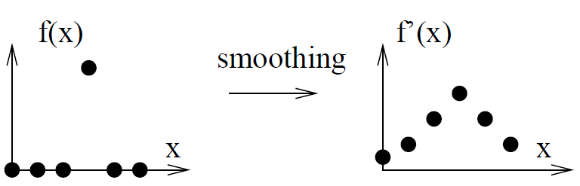
Fitness smoothing
Fitness Function - Examples
Fitness functions with large plateaus can be made easier for guided search if we modify objective function and consider objective function value of neighbors
Smoothing the fitness landscape is a possible way to achieve this

Slide 214
Constraint handling
Fitness Function - Examples
We have to assign fitness values to solutions that are infeasible
Necessary if we cannot exclude all infeasible solutions from search space
Simplest choice: penalize violation of constraints
Penalty functions depend highly on parameters
Proper design of fitness function for constrained problem is demanding

Slide 215
Accuracy-efficiency tradeoff
Fitness Function - Examples
Evaluation of fitness functions must be fast
If calculation of fitness is time-consuming
  Rough approximation of fitness function could be used at beginning
  Increase precision during run
  Invest more time at the end of run
  Local search: compute only fitness change (if faster and no need for complete fitness evaluation exists)

Slide 216
Initialization

Slide 217
Impact of initialization
Initialization
Proper choice of initial solutions has large effect on efficiency of modern heuristics
Initial solutions are starting points for search
For guided search: single solution
For recombining methods: population of solutions

Slide 218
Random initialization
Initialization
Proper choice of initial solutions depends on amount of problem-specific knowledge
If we know no properties of high- or low-quality solutions, we recommend random initialization
All solutions are created with same probability, covering the entire search space
Unbiased sampling
  might be hard to ensure for direct representations
  easier for standard genotypes (integer, binary…)

Slide 219
Using problem specific knowledge
Initialization
If we know something about structure of high- or low-quality solutions like
  variable ranges,
  Dependencies, or
  good solution parts
we can use such solutions as initial solutions
Advantage: guides the search into direction of optima
Disadvantage: reduces search range
Too much bias can lead to premature convergence because
  Solutions are too similar (recombining methods)
  search focuses too much on certain parts of search space (recombining methods, and local search)

Slide 220
Search Strategies
Diversification and Intensification
Example: VNS
Example: Genetic Algorithm

Slide 221
Intensification and Diversification
Search Strategy – Diversification and Intensification
Different strategies for controlling search differ in the design and control of the intensification and diversification phases
Search strategies must balance intensification and diversification during search and to allow search methods to escape from local optima.
This is achieved by various diversification techniques based on the representation, search operator, fitness function, initialization, or explicit diversification steps controlled by the search strategy.

Slide 222
Local and Recombination-based Search
Search Strategy – Diversification and Intensification
Two fundamental concepts for heuristic search:
  local search methods versus (high-locality problems)
  recombination-based search methods (decomposable problems)
Many real-world problems have high locality and are decomposable
Direct comparisons between local and recombination-based search is only meaningful for particular problem instances
General statements on the superiority of one or other of these basic concepts are unjustified as method performance depends on the specific characteristics of the problem (locality versus decomposability).

Slide 223
Strategies for Intensification
Search Strategy – Diversification and Intensification
Intensification steps use the fitness of solutions to control search and usually ensure that the search moves in the direction of solutions with higher fitness.
Keep the high-quality solutions or discard the low-quality ones
No heuristic search possible without selection
Intensification too strong (high selection pressure)
  Premature convergence
  Search gets stuck in local optimum
Intensification too weak (low selection pressure)
  Drift
  High running times and low progress
Optimal strength of intensification is problem-specific (example: evolution strategies)

Slide 224
Strategies for Diversification: Representation and Search Operators
Search Strategy – Diversification and Intensification
Choosing a combination of representation and search operators is equivalent to defining a metric on the search space
Representation/operator combination defines which solutions are neighbors.
By using different types of neighborhoods, it is possible to escape from local optima and explore larger areas of the search space.
Different neighborhoods can be the result of different genotype-phenotype mappings or search operators applied during search.
Standard examples for local search approaches that use modifications of representations or operators to diversify the search are variable neighborhood search, problem space search, the rollout algorithm, or the pilot method.

Slide 225
Strategies for Diversification: Fitness Function
Search Strategy – Diversification and Intensification
Fitness function measures the quality of solutions.
Modifying the fitness function has the same effect as changing the representation as it assigns different fitness values to the problem solutions.
Variations and modifications of the fitness function lead to increased diversification
Common example is guided local search (it systematically changes the fitness function with respect to the progress of search)

Slide 226
Strategies for Diversification: Initialization
Search Strategy – Diversification and Intensification
Search trajectory depends on the choice of the initial solution (for example, greedy search always finds the nearest local optimum)
Diversification can be the result of search heuristics using different initial solutions.
Multi-start search approaches explore a larger area of the search space and lead to higher diversification.
Variants of multi-start approaches include iterated descent, large-step Markov chains, iterated Lin-Kernighan, chained local optimization, or iterated local search.

Slide 227
Strategies for Diversification: Search Strategy
Search Strategy – Diversification and Intensification
The search strategy can control the sequence of diversification and intensification steps.
Diversification steps that do not move towards solutions with higher quality can either be the results of random, larger, search steps or based on information gained in previous search steps.
Examples of search strategies that use a controlled number of search steps towards solutions of lower quality to increase diversity are simulated annealing, threshold accepting, or stochastic local search.
Representative examples of search strategies that consider previous search steps for diversification are tabu search or adaptive memory programming.

Slide 228
Variable neighborhood search (VNS)
Search Strategy – VNS
Combines local search with dynamic neighborhood structures that are changed depending on the progress of search
Based on the following observations:
  Local minimum for neighborhood A is not necessarily one for neighborhood B. Different neighborhoods result in different metrics, result in different fitness landscapes.
  A global minimum is a global minimum with respect to all possible neighborhoods. Neighborhoods change definition of solution similarity, but not the fitness.
  Global optimum is not affected by search operators, but only local optima are affected by search operators!

Slide 229
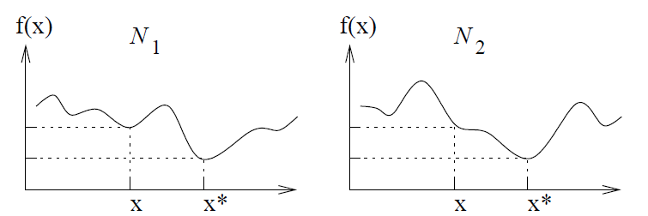
Variable neighborhood search (VNS)
Search Strategy – VNS
Local optima for different neighborhoods are often close to each other
Local optima have structure and properties that are also relevant for global optimum (similar to decomposability: parts of solution need to be recombined)
Local optima are not randomly scattered through search space but are clustered together
Changing the neighborhood from N1 to N2 allows local search to find optimal solution

Slide 230
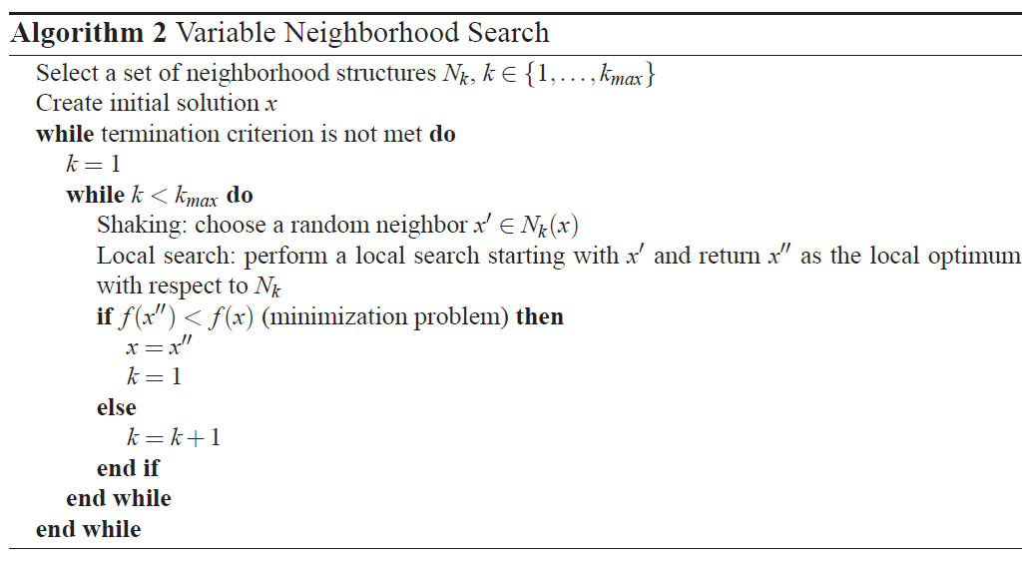
VNS pseudo-code
Search Strategy – VNS

Slide 231
VNS in a nutshell
Search Strategy – VNS
Define k different neighborhoods
|N(x)|_{k} is average number of neighbors
Usually we order the neighborhoods in increasing |N(x)|_{k}
VNS iteratively performs a
  Shaking phase: select a random solution w.r.t. current neighborhood. Avoids cycling and explores new region
  Local search phase: Perform local search until local optimum is found
  Switch to next neighborhood
  Track best found local optimum

Slide 232
Intensification and diversification in VNS
Search Strategy – VNS
Local search focuses search
Shaking and switching neighborhoods are diversification steps
Since average number of neighbors grows with k, diversification gets stronger
  Local search can select from more neighbors
  Covers larger areas of search space
  Sizes of basins of attraction increase
Although VNS is recently quite popular, the underlying ideas are actually old (see Design of Modern Heuristics, p. 136)

Slide 233
Pilot Method
Search Strategy – Pilot Method
“Preferred Iterative LOok ahead Technique”
Combines greedy construction heuristics with a greedy measure to estimate the global impact of local choice
Constructs solution step by step (Master solution)
Decides about the steps by completing the solution using a fast construction heuristic, the so-called pilots
Pilots look ahead. Similar to A* search
Master solution evolves, Pilots are iteratively computed

Slide 234
Pilot Method for TSP (1)
Search Strategy – Pilot Method
Combinatorial optimization problem defined on fixed set of elements E
Cost function c:E! R
Find minimal cost subset S*½E satisfying some constraints
TSP: find set of edges with minimal cost that forms a cycle
Assume that a heuristic for the problem is known that can complete any partial solution

Slide 235
Pilot Method for TSP (2)
Search Strategy – Pilot Method
Master solution M contains elements e
For each e2M extend partial solution M to a complete solution such that e is part of it
Let p(e) denote objective function value of this solution
e₀ is most promising pilot: minimal value p() from all e2M.
Include e into M. Start over.
Terminate when M is complete.

Slide 236
Properties
Search Strategy – Pilot Method
Greedy construction heuristic that "looks ahead"; no search through a search space
Completion heuristic is designed such that it exploits problem knowledge
No explicit diversification steps
See chapter on design principles (ordinal representation)

Slide 237
Evolution strategies (ES)
Search Strategy – Evolution Strategies
Local search for continuous search spaces
Developed by Rechenberg and Schwefel, TU Berlin
First applications: optimize shape of a bent pipe
The main search operator in ES is mutation. To exchange information between solutions, recombination operators are used in population-based ES as background search operators.

Slide 238
(1+1)-ES
Search Strategy – Evolution Strategies
n-dimensional continuous vector x2R is solution
Creates offspring x‘ by adding n-dimensional random variable, mostly Gaussian:
  x_{i}‘ = x_{i} + ¾ N_{i}(0,1)
Offspring replaces parent if it is better
Stochastic hillclimber

Slide 239
Two standard problem models
Search Strategy – Evolution Strategies
Corridor model (x is far from optimum)
  f_{corr} (x) = c₀ +c₁ x₁ 8 i2{2,…, n}: -b/2· x_{i}· b/2
Sphere model (x is close to optimum)
  f_{sphe} (x) = c₀ + c₁∑_{i} (x_{i}–x_{i}*)²

Slide 240
1/5th success rule
Search Strategy – Evolution Strategies
Define »(t) as ratio of successful steps over all t search steps
For corridor and sphere model, »(t)=0.2 maximizes convergence speed
If »(t)>0.2 reduce ¾, increase otherwise

Slide 241
(¹+¸), (¹,¸)- evolution strategies
Search Strategy – Evolution Strategies
¹ parents generate ¸ new solutions.
¹ offspring are chosen either from ¹+¸ ((¹+¸)-ES) or from the ¸ new solutions ((¹,¸)-ES)
Each individual has an own ¾.
Self-adaptation of strategy parameters (¾ is not externally controlled).
Step size is adapted (learned) during the run

Slide 242
Properties
Search Strategy – Evolution Strategies
ES incorporate the most important parameters of the strategy, e.g. standard deviations, into the search process. Thus, optimization not only takes place on object variables, but also on strategy parameters (self-adaption).
In population-based ES, intensification is a result of the selection mechanism which prefers high-quality solutions.
Recombination is a background operator which has both diversifying and intensifying character.
  By recombining two solutions, new solutions are created which lead to a more diversified population.
  However, especially intermediate crossover leads to reduced diversity during an ES run since the population converges to the mean values.
Like for (1+1)-ES, the main source of diversification is mutation. With larger standard deviations, diversification gets stronger as the step size increases. The balance between diversification and intensification is maintained by the self-adaptation of the strategy parameters.

Slide 243
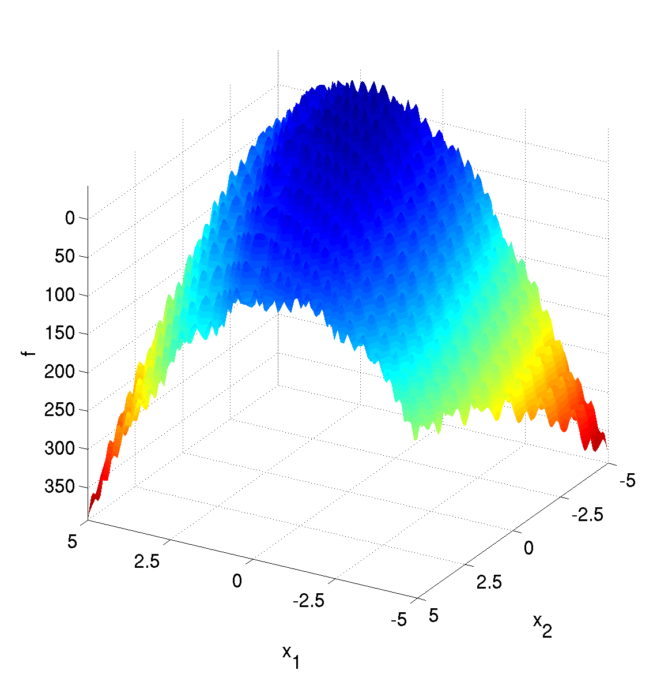
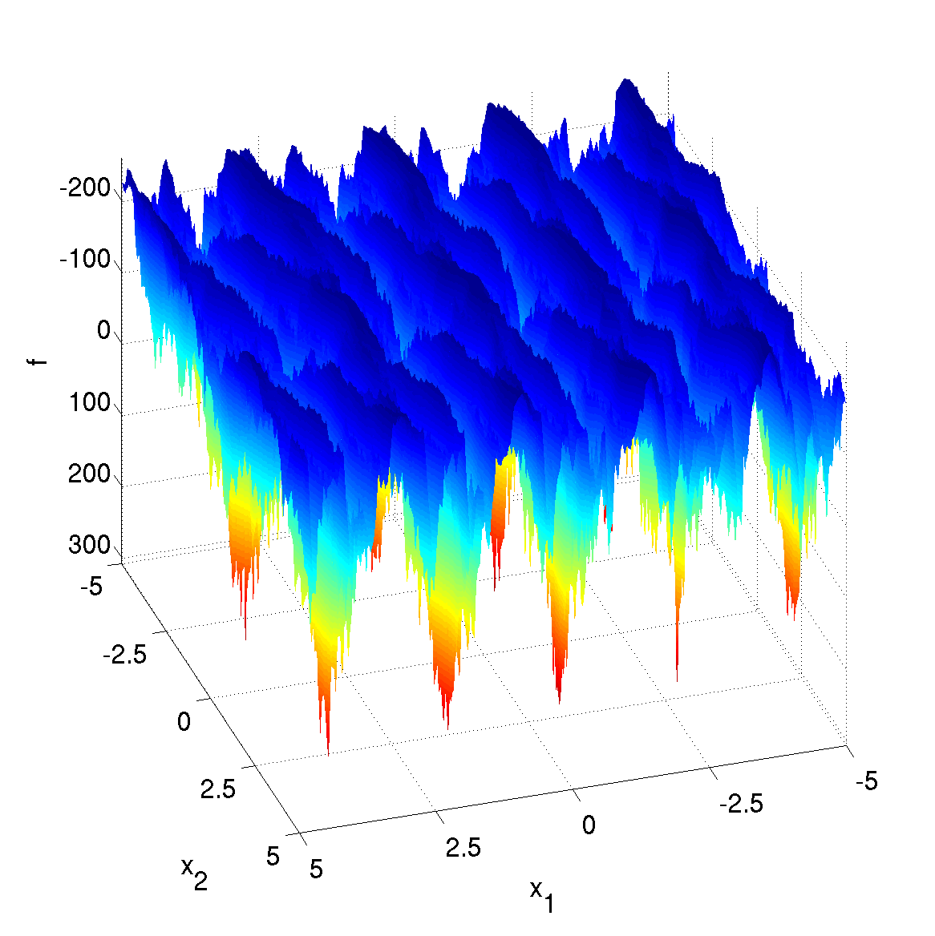
State of the art
Search Strategy – Evolution Strategies
ES are state-of-the-art for many nonlinear continuous functions with medium dimensionality (n<100)
CMA-ES (Covariance Matrix Adaptation Evolution Strategy) from Hansen and co-workers

Slide 244
Principles of Genetic Algorithms
Search Strategy – Genetic Algorithm
Population of solutions.
  properties of a solution are evaluated based on the phenotype
  variation operators are applied to the genotype.
  some of the solutions are removed from the population if the population size exceeds an upper limit.
Variation operators
  create new solutions with similar properties to existing solutions.
  main search operator is recombination
  mutation serves as background operator
Selection
  High-quality individuals are selected more often for reproduction.

Slide 245
Functionality
Search Strategy – Genetic Algorithm
4. Heuristic Optimization Methods – Genetic Algorithms
Generate set of different initial solutions
Repeat until termination :
  Repeat within a population
    Combine several solutions to form a new one s‘
    Create a random neighboring solution s‘ in the neighborhood N(s) of s
  Select only a fraction of the newly created solutions s‘.
search space S
Initial solution 2
Different neighborhood in comparison to local search
Initial solution 1
Initial solution 3
new solution
mutation
Notes:
S ungleich X (da ggf. unzulässige Lösungen in S enthalten sind usw.)
Anmerkung: 2 hoch S ist die Potenzmenge von S (Menge aller Teilmengen von S)
Oder: N Teilmenge SxS (kartesisches Produkt)

Slide 246
How does a GA work?
Search Strategy – Genetic Algorithm
4. Heuristic Optimization Methods – Genetic Algorithms
pop = random_population();
while (not done)
parents = {};
while (|parents| < |pop|)
x = tournament_winner(pop);
parents = parents + x;
end;
offspring = {};
while (|offspring| < |pop|)
x = get_random_with_deletion(parents);
y = get_random_with_deletion(parents);
(x’,y’) = crossover(x,y);
x” = mutation(x’);
insert(x”,offspring);
y” = mutation(y’);
insert(y”,offspring);
end;
pop = offspring;
end;
Selection
Variation
Generation

Slide 247
Genetic algorithms
Search Strategy – Genetic Algorithm
4. Heuristic Optimization Methods – Genetic Algorithms
Two or more solutions create offspring using a recombination operator
Assumption:
  Solutions have characteristic properties
  Recombination has to identify relevant characteristics (building blocks) and combine those characteristics in an offspring.
  Population necessary to ensure that different characteristica are available.
Motivation: local optima for local search are no local optima for recombination-based search.
However: Resulting neighborhood structure is non-intuitive
Notes:
S ungleich X (da ggf. unzulässige Lösungen in S enthalten sind usw.)
Anmerkung: 2 hoch S ist die Potenzmenge von S (Menge aller Teilmengen von S)
Oder: N Teilmenge SxS (kartesisches Produkt)

Slide 248
Design choices
Search Strategy – Genetic Algorithm
4. Heuristic Optimization Methods – Genetic Algorithms
Choose a proper representation and corresponding search operators for the problem (ensure high locality for mutation and recombination)
Design a mechanism that compares quality of different solutions.
Set GA-specific parameters:
  Population size (with increasing population size solution quality increases; running time (number of generations) is independent of pop size!).
  High recombination probability
  Low mutation probability (on allele level) to create similar solutions

Slide 249
Intensification
Search Strategy – Genetic Algorithm
Due to selection
In each selection step, the average fitness of a population increases as only high-quality solutions are chosen for the mating pool
Due to selection, the population converges after a number of generations
Continuing recombination-based search after the population has converged (hopefully to the global optimum) makes no sense as diversity is minimal.

Slide 250
Diversification
Search Strategy – Genetic Algorithm
Main source of diversification is the initial population
Therefore, large population are used
Recombination operators
  Can create new solutions
  No active diversification. Recombination reduces diversity as the distances between offspring and parents are usually smaller than the distance between parents
  Iterative application of crossover alone reduces the diversity of a population as
    some solution properties can become extinct in the population (drift)) or
    the decision variables converge to an average value (especially for continuous decision variables).

Slide 251
Diversification (2)
Search Strategy – Genetic Algorithm
Mutation has diversifying character
Neighborhood structure does not remain constant during search, as mutation does not generate only neighboring solutions with small distance but can reach all solutions in the search space in only one mutation step.
Mutation is iteratively applied to all l decision variables with probability p_{m}.
On average, p_{m}l alleles are mutated
For large values of p_{m}, the mutation operator can mutate all l decision variables and, thus, reach all possible points in the solution space.
The diversifying character of mutation increases with increasing p_{m}, and for large p_{m}, SGA behaves like random search.

Slide 252
Design Principles
High Locality
Bias

Slide 253
Design Guidelines
Design Principles – High Locality
Vast majority of real-world optimization problems are
neither deceptive nor difficult and
have high locality (used metric is meaningful)
Design of modern heuristics should not destroy the high locality of a problem.
Local search operators must generate neighboring solutions
Recombination operators must re-combine solutions

Slide 254
Biasing modern heuristics
Design Principles - Biasing
If we know something about good solutions, we can seed such information into the modern heuristic
  Representation: incorporate construction heuristics, or use redundant encodings
  Search operators can distinguish between good and bad solution features (building blocks)
  We can also bias the fitness function, the initial solutions, the search strategy

Slide 255
Incorporating Construction Heuristics in Representations
Design Principles - Biasing
Early example: ordinal representation (Grefenstette et al. 1985) for the TSP.
Encodes a tour (permutation of n integers) by a genotype x^{g} of length n, where x^{g} _{i}2{1,…,n-i} and i2{0,…,n-1}. For constructing a phenotype, a predefined permutation x^{s} of n integers representing the n different cities is used. x^{s} can be problem-specific and, for example, consider edge weights. A phenotype (tour) is constructed from x^{g} by subsequently adding (starting with i=0) the x^{g}_{i}th element of x^{s} to the phenotype (which initially contains no elements) and removing the x^{g}_{i}th element of x^{s}. Problem-specific knowledge can be considered by choosing an appropriate x^{s} as genotypes define perturbations of x^{s} and using small integers for the x^{g} _{i} results in a bias of the resulting phenotypes towards x^{s}. For example, for x^{g}_{i}=1 (i2{0,…,n-1}), the resulting phenotype is x^{s}.

Slide 256
Biased representation
Design Principles - Biasing
Number of genotypes exceeds number of genotypes
Redundant representations
Redundant representations are biased if some phenotypes are represented by a larger number of genotypes
Biased representation: overrepresentation of good solutions, good solutions take larger share of search space

Slide 257
Biased search operators
Design Principles - Biasing
Search operators are biased if they generate or select certain solutions with higher probability
Integration of structural features into new solutions
Example: optimal TSP solutions do not cross
  Operators should not generate crossing solutions because they have bad quality

Slide 258
Biased fitness function
Design Principles - Biasing
Fitness function is objective function as the heuristic sees it
Improve fitness of solutions that share a desired feature
Penalize solutions that do not share a certain feature
Handle constraints: penalize solutions that violate certain constraints

Slide 259
Biased search strategy
Design Principles - Biasing
If problem is known to be unimodal, we can favor intensification and use less exploration
If problem is known to be multimodal, local minima are more important and we must diversify
Example: use different starting temperatures in Simulated Annealing approach, depending on multimodality of search space

Slide 260
Done
TexPoint fonts used in EMF.
Read the TexPoint manual before you delete this box.: AAAAAAAAA

