Slide 1
The structure of the “lectures“
Klaus Wälde
Gutenberg University Mainz
www.waelde.com

Slide 2
Learning with and from experts
By courtesy of Gary Colet
https://www.linkedin.com/in/garycolet
Notes:
Presentation / lecturing vs Socratic enquiry / critical thinking / tacit knowledge exchange
Originator of the ‘Masterclass’ Franz Liszt

Slide 3

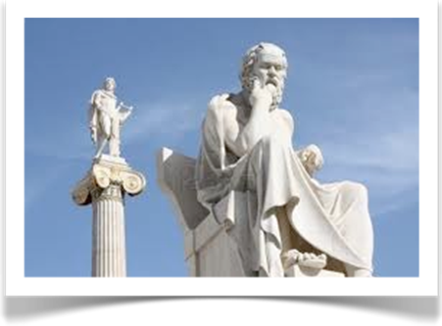
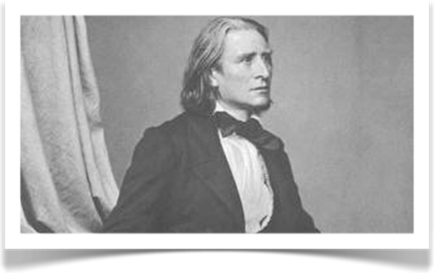
Learning with and from experts
Socrates, Greek philosopher
470BC - 399BC
Franz Liszt, Hungarian composer
1811 - 1886
Notes:
Presentation / lecturing vs Socratic enquiry / critical thinking / tacit knowledge exchange
Originator of the ‘Masterclass’ Franz Liszt

Slide 4




The structure of the “lectures”
1. Fix the learning objectives
2. Illustration of approach for a first case study by the expert
3. Students go through another case study
4. The expert view, contrasted with the students‘ views on the second case study

